Slide 1



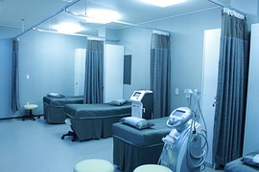
CURA-HMS

Slide 2

AGENDA

Slide 3

Agenda
Problem statement
Project description
Team working agreement
Personas
Sprint Summary
Technologies
Algorithms
Product Backlog
Sprint 8 Backlog
Metrics
Retrospective
Project Demo
Live Application
Team member roles and responsibilities
MVP
Diagrams
Improvements made from professor

Slide 4



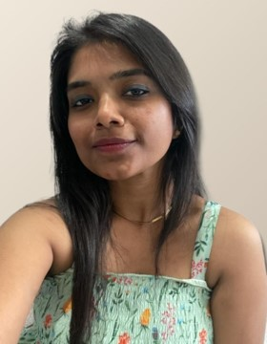
Meet Our Team
SAI TEJA KORIBILLI
BINDU VALISETTY
KULDEEP KALUVALA
MOUNIKA THALLA
SCRUM MASTER
DATABBASE
ADMINISTRATOR
UI/UX DEVELOPER
DEVELOPER
PROJECT MANAGER

Slide 5
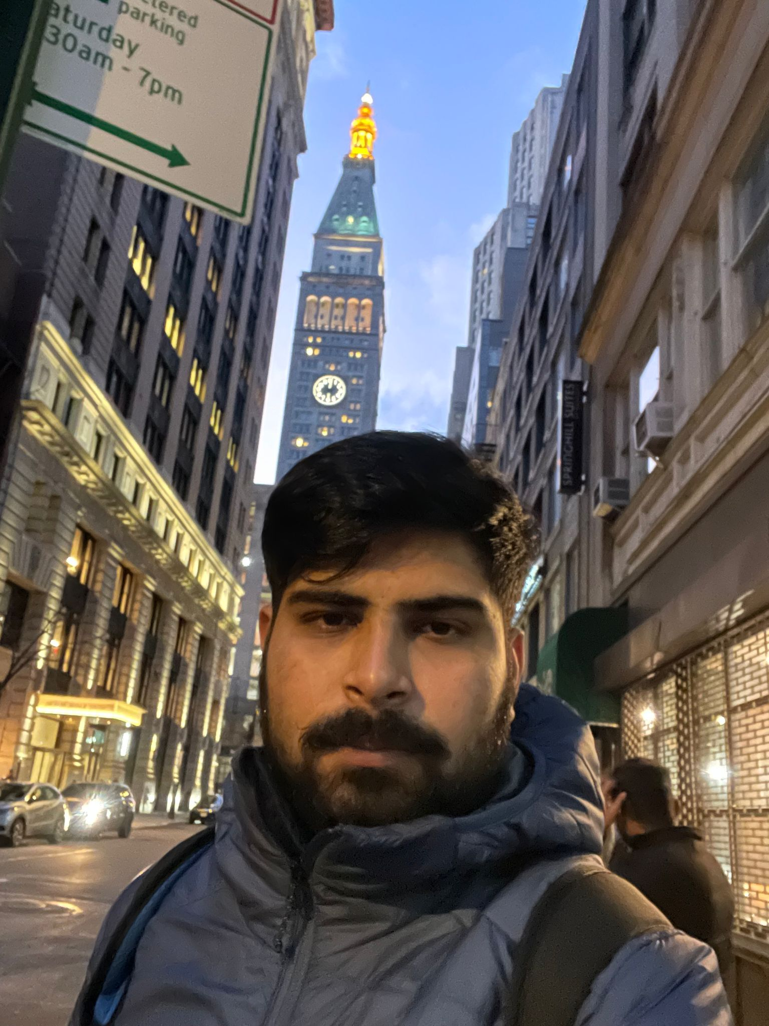


Meet Our Team
SHIVANSH TOMAR
NIKHIL
JIGAR SHAH
QUALITY
ANALYST EGINEER
DEVELOPER
DEVELOPER

Slide 6
Problem Statement
Most hospitals are still facing several challenges with Hospital Management System because some of them are still using manual processes, while those who are using computerized method are also facing the challenge of adjusting to it. Like:
The high cost of software development and deployment.
Complex design in terms of User Interface and User Experience (UI/UX Design)
Fear of data security breach.
Difficulty in migrating from manual processes, because both staff and patients are used to the manual processes and so are unable to speedily cope with the new system.
Lack of IT-friendly medical personnel is also presenting several challenges.
A Huge influx of patients visiting government hospitals makes the process of migrating to automated processes highly difficult. They do not have the patience to wait for registration and data entry and often fail to understand the functioning of automated processes.

Slide 7
Project Description
Project Description
Project Name: | Cura HMS
Team Name: | Medical Maestros
Project Description: | CURA helps to automate routine tasks, optimize staff coordination, improve communication, distribute the workload, store different types of information, and provide financial and HR management. For patients who want to book an appointments, the CURA is a web app that provides a hassle-less to book an appointment with doctor, unlike the traditional way where we had to call or text and ask for doctor’s availability our cura app is a tool that collects data about patients, doctors, staff, hospital administrative details in one software.
Benefit Outcomes: | Patients can book appointments with particular Doctor according to their preferred date and time . Doctors can see the appointment list of patients and schedule his duties at hospital .
GitHub Wiki: | https://github.com/htmw/HMS/wiki

Slide 8
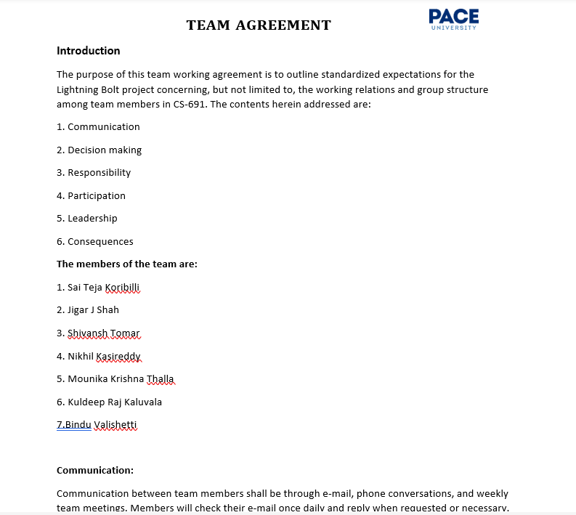
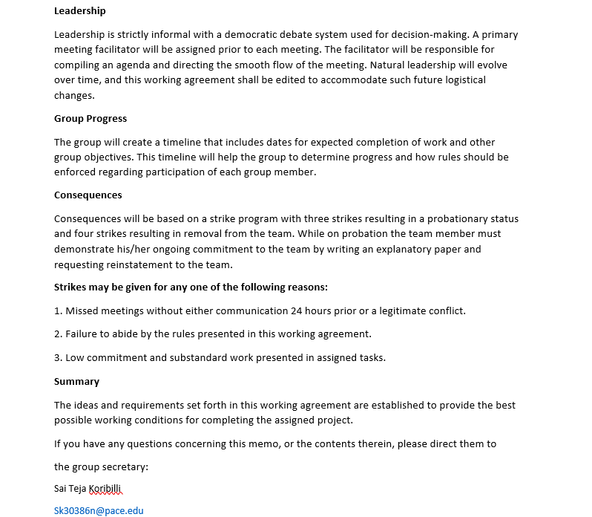
Team Working Agreement

Slide 9


PERSONAS

Slide 10
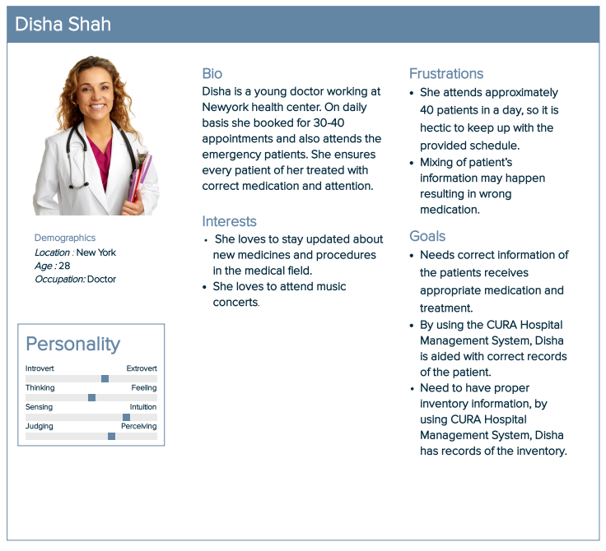
Persona 1

Slide 11
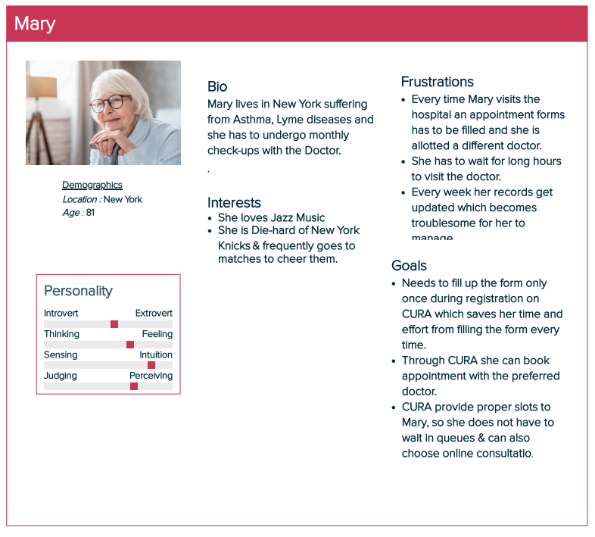
Persona 2

Slide 12
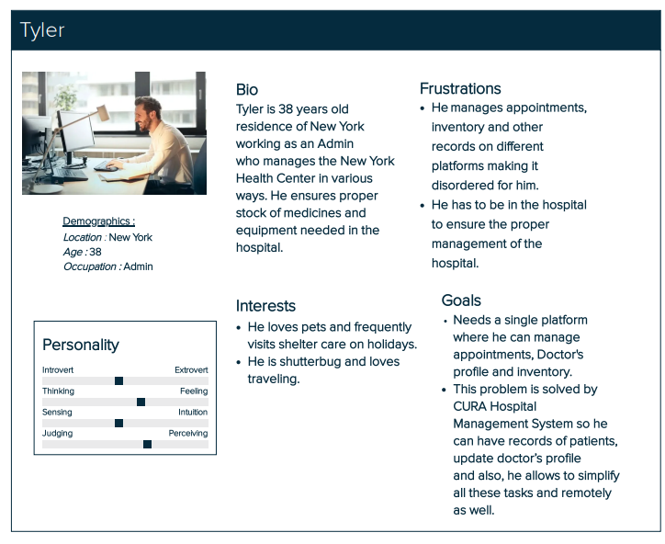
Persona 3

Slide 13
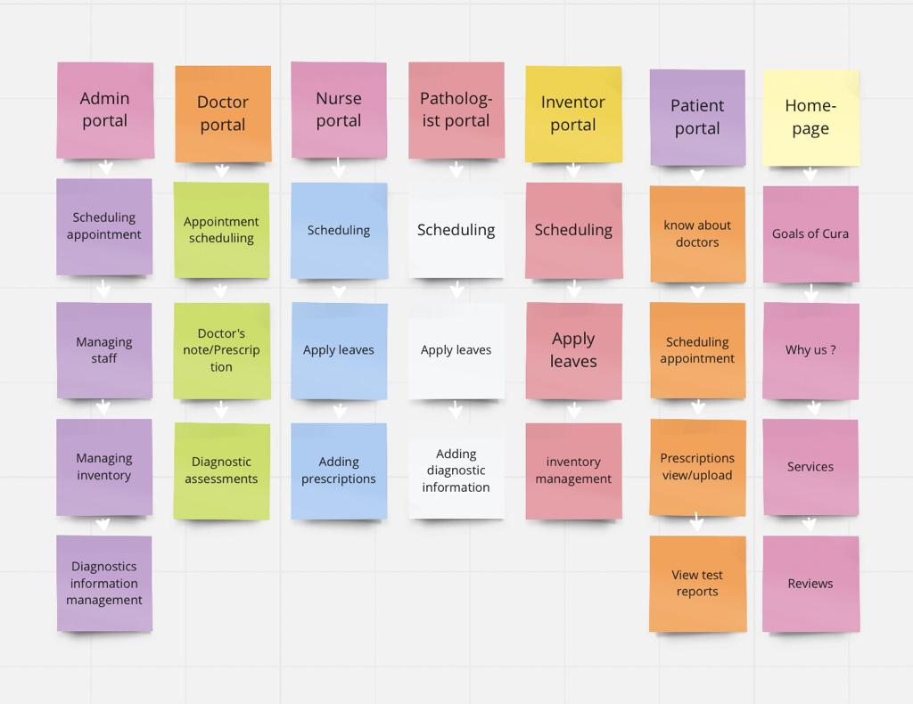
Minimum Viable Product (MVP)

Slide 14









TECHNOLOGIES
FRONT END
Java Script
BACK END/ SERVER
DATABASE
TESTING
CUCUMBER
API
TOOLS

Slide 15

Algorithm
The proposed system has five modules for doctors, admin, pathologists, inventors and patients providing facilities for appointment schedules, payment, viewing online information, register on hospital website. The whole process of information sharing and processing in this system is automated through the Decision Tree ID3 algorithm
What is ID3 Algorithm?
ID3 stands for Iterative Dichotomiser 3 and is named such because the algorithm iteratively (repeatedly) dichotomizes(divides) features into two or more groups at each step.
ID3 uses a top-down greedy approach to build a decision tree. In simple words, the top-down approach means that we start building the tree from the top and the greedy approach means that at each iteration we select the best feature at the present moment to create a node. Attempts to create the smallest possible decision tree.

Slide 16
ID3 ALGORITHM
Before you inquire, the response to the question: "How does ID3 choose the best feature?" is that ID3 uses Information Gain, or simply Gain, to identify the best feature.
Information Gain determines the entropy decrease and assesses how effectively a particular feature categorizes or separates the target classes. The most effective feature is the one that has the greatest Information Gain.
Simply put, entropy is a measure of disorder, and a dataset's entropy is a measure of disorder in the feature that is being measured.
Entropy is 0 for homogeneous (similar) values in the target column in the case of binary classification (where the target column has only two types of classes), and it is 1 for equal numbers of values in the target column for both classes.

Slide 17
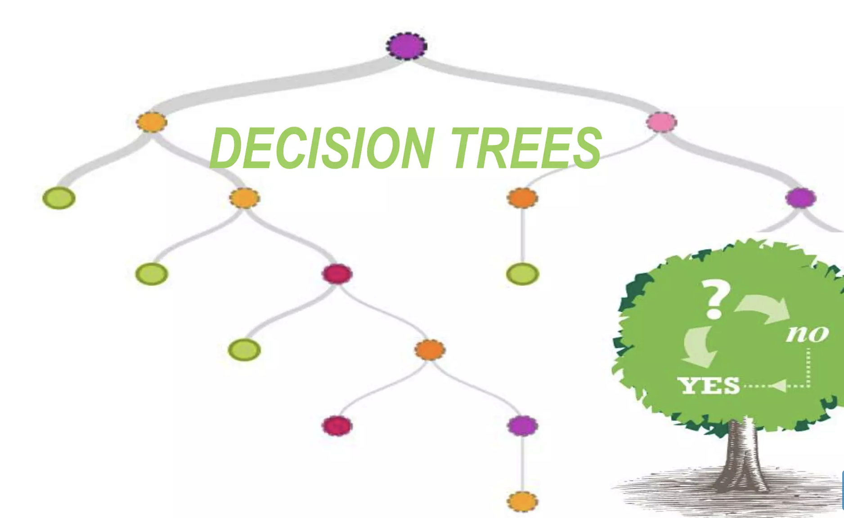
ID3 ALGORITHM
Calculate the Entropy of every attribute using the data set.
Split the set into subsets using the attribute for which entropy is minimum (or, equivalently, information gain is maximum).
﻿Make a decision tree node containing that attribute.
﻿Recurse on subsets using remaining attributes.

Slide 18

Diagrams

Slide 19
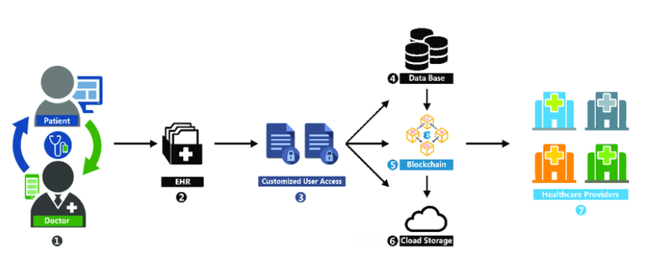

CONCEPTUAL ARCHITECURE DIAGRAM

Slide 20
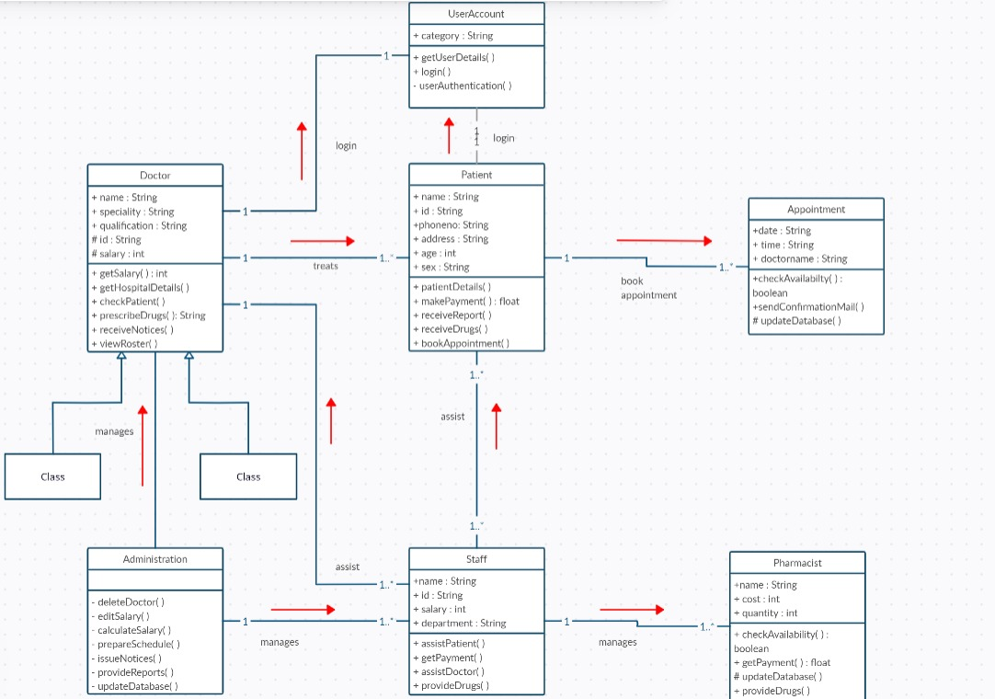
CLASS DIAGRAM
OF
CURA

Slide 21
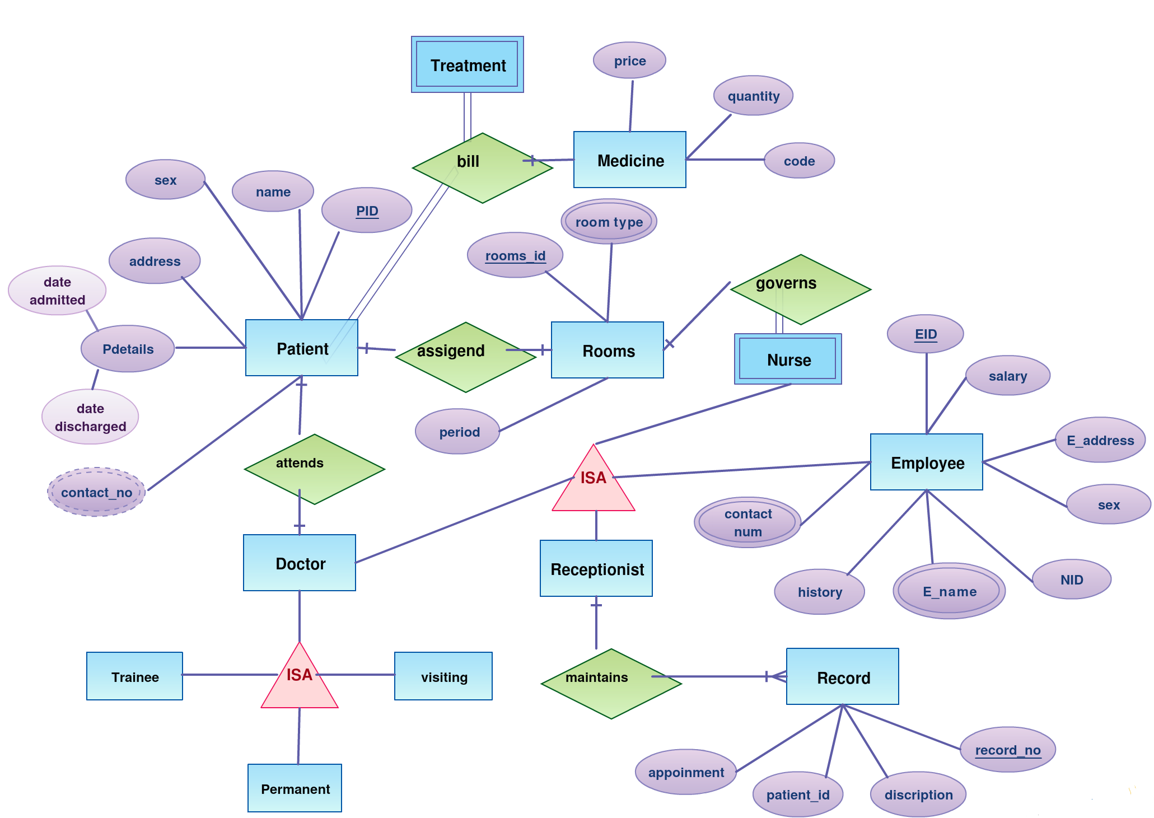
ER DIAGRAM

Slide 22
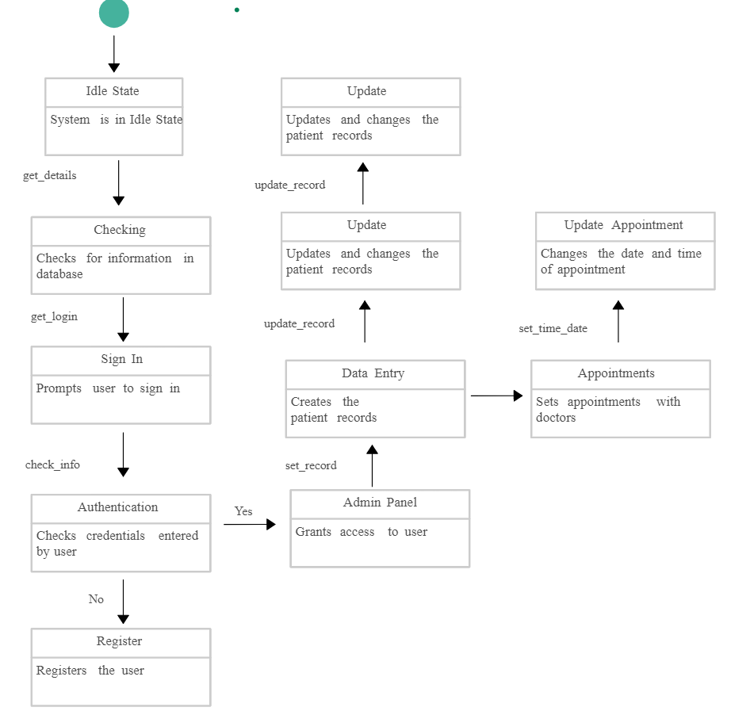
STATE DIAGRAM

Slide 23
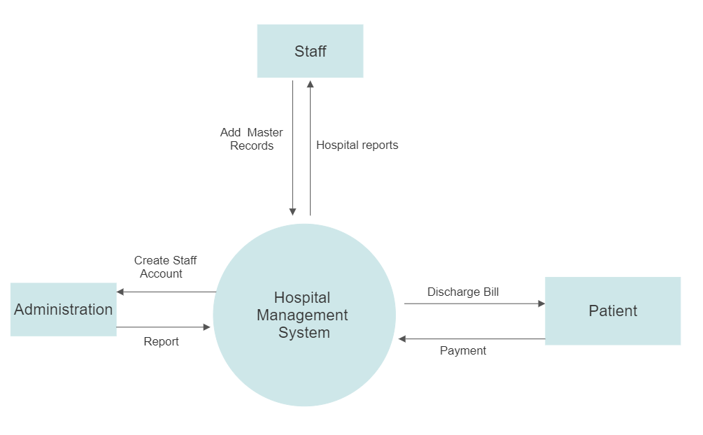
Dataflow
Diagram
Level 0

Slide 24

SPRINT SUMMARY

Slide 25

25
SPRINT 1
Issue Type | Key | Name
Task | CURA-4 | Work on deliverable 1 presentation
Task | CURA-3 | Establish weekly meetings
Task | CURA-5 | Establish team roles
Task | CURA-1 | Setup development tools (GitHub and Jira)
Task | CURA-2 | Create a significant business application

Slide 26
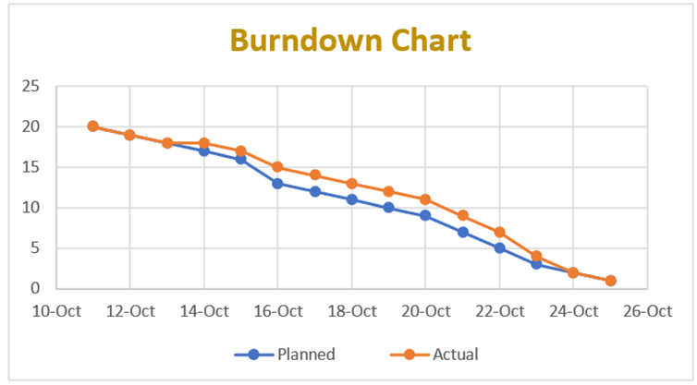
Issue Type | Id | Name | Story Points Estimate
Story | CURA-10 | As a patient, I want to register and sign in successfully, so that I can store all my account details. | 3
Story | CURA-13 | As a doctor, I want to go-through the appointments list. | 3
Story | CURA-15 | As a patient, I want to book an appointment. | 3
Story | CURA-16 | As an admin, I should be able to access and manage all the data and modify according to requirements. | 5
SPRINT 2

Slide 27
Issue Type | Id | Name | Story Points Estimate
Story | CURA-12 | As an Inventor, I want to know whether the supplies are as per the requirement or no, so that I can re-stock them. | 3
Story | CURA-14 | As an Admin, I want to navigate to the billing section to check whether the bills produced are accurate or not. | 5
Story | CURA-15 | As a Staff, I want to check room availability and manage rooms according to requirements. | 3
SPRINT 3

Slide 28
Issue Type | Id | Name | Story Points Estimate
Story | CURA-16 | As a Patient , I would like to update my profile so that I can update my Name, Address, and Phone No. in it. | 3
Story | CURA-18 | As a Patient , I would like to book an appointment with a specific doctor so that will be easy to find solution for my problem. | 3
Story | CURA-20 | As a Patient, I would like to have a landing page that det ails all the advantages of the platform in order to encourage me to sign up. | 3
Story | CURA-25 | As a Doctor , I want to see appointment list so that I will get an idea how many patients book an appointment through portal. | 3
Task | CURA-26 | Final Technical Paper | 5
SPRINT 4

Slide 29
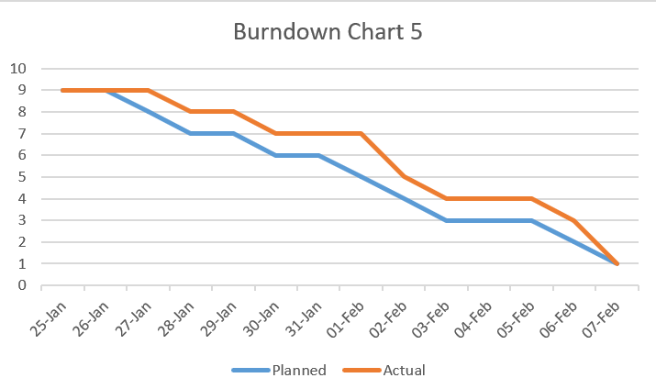

Issue Type | Key | Name | Story Points Estimate
Story | CURA - 39 | As a patient, I want to able to search on the app, so that I can find the necessary information . | 3
Story | CURA - 40 | As a patient, I want to update my profile and also upload reports so that doctor can know the patient condition. | 3
Story | CURA - 41 | As an admin, I want to see all the doctor's list in the application so that, I can manage the system according to my need. | 3
29
SPRINT 5

Slide 30
Issue Type | Key | Summary | Story Points Estimate
Story | CURA – 31 | As a Patient, I want to submit my symptoms/previous history documents in the portal for assessment so that I may receive a accurate determination . . | 3
Story | CURA - 30 | As a Patient, I want to confirm whether my appointment with the doctor is set up or no so that I can have an idea about my appointment with doctor. | 3
Story | CURA - 33 | As a Pathologist, I want to know whether samples of the patient are correctly entered or no, so that there is no confusion with patient's details with others. | 5
Story | CURA-37 | As a Pathologist I want to upload patient test results in portal so that it will be easy to check report for Doctor before patient’s appointment . | 3
30
SPRINT 6

Slide 31
User Story Id | Summary | Story Points Estimate
CURA-29 | As a Doctor, I want to see my particulars/schedule/profile on the application so that I can plan my duties at the hospital. | 3
CURA-34 | As an Admin, I want to navigate to doctor/staff/nurse section to check the log-in time so that I can verify whether every doctor/nurse/staff is attending the hospital on time. | 5
CURA-39 | As a nurse, I want to see the prescriptions given by the doctor to the patients through the nurse portal. | 3
CURA-32 | As an Inventor, I want to know whether the supplies are as per the requirement or not so that I can re-stock them. | 3
SPRINT 7

Slide 32

PRODUCT BACKLOG

Slide 33
Product Backlog
Issue Type | ID | Summary | Status | Story Points | Priority
Story | CURA-30 | As a Patient, I want to confirm whether my appointment with the doctor is set up or no so that I can have an idea about my appointment with doctor. | Done | 5 | High
Story | CURA-34 | As an Admin, I want to navigate to doctor/staff/nurse section to check the log-in time so that I can verify whether every doctor/nurse/staff is attending the hospital on time. | Done | 5 | High
Story | CURA-32 | As an Inventor, I want to know whether the supplies are as per the requirement or no, so that I can re-stock them. | Done | 3 | Medium
Story | CURA-10 | As a patient, I want to register and sign in successfully, so that I can store all my account details. | Done | 3 | Medium
Story | CURA-33 | As a Pathologist, I want to know whether samples of the patient are correctly entered or no, so that there is no confusion with patient's details with others. | Done | 2 | Low
Story | CURA-15 | As a patient, I want to book an appointment with Doctor . | Done | 2 | Low

Slide 34
Product Backlog
Issue Type | ID | Summary | Status | Story Points | Priority
Story | CURA-35 | As an Admin can add doctors, add staff, view the details, and can also modify them. | Done | 5 | High
Story | CURA-31 | As a Patient, I want to submit my symptoms/previous history documents in the portal for assessment so that I may receive an accurate determination. | Done | 5 | High
Story | CURA-29 | As a Doctor, I want to see my particulars/schedule/profile on the application so that I can plan my duties at hospital . | Done | 3 | Medium
Story | CURA-37 | As a Pathologist, I want to upload patient test results in the portal so that it will be easy to check reports for Doctors before the patient’s appointment. | Done | 3 | Medium
Story | CURA-38 | As a nurse, I want to write prescriptions for the patients as directed by the doctor and can also upload prescription documents also. | Done | 3 | Medium

Slide 35
Product Backlog
Issue Type | ID | Summary | Status | Story Points | Priority
Story | CURA-40 | As an Admin I can able to reschedule the appointments or even cancel the appointments with Doctors. | Done | 3 | Medium
Story | CURA-41 | As an Admin, I can be able to rate the doctor and also adding hospitals list for referrals to patients if any further assistance needed for diagnosing the disease . | Done | 3 | Medium
Story | CURA-39 | As a nurse I want to see the prescriptions given by the doctor to the patients through the nurse portal. | Done | 2 | Low

Slide 36

SPRINT 8 BACKLOG

Slide 37
Sprint 8 Backlog
User Story Id | Summary | Story Points Estimate
CURA-40 | As an Admin I can able to reschedule the appointments or even cancel the appointments with Doctors. | 3
CURA-41 | As an Admin, I can be able to rate the doctor and also adding hospitals list for referrals to patients if any further assistance needed for diagnosing the disease . | 3
CURA-38 | As a nurse, I want to write prescriptions for the patients as directed by the doctor and can also upload prescription documents also. | 3

Slide 38

USER STORIES & ACCEPTANCE CRITERIA

Slide 39
User Stories & Acceptance Criteria
User Story ID | Summary | Status
CURA-29 | As a Doctor, I want to see my particulars/schedule/profile on the application so that I can plan my duties at the hospital. | Done
 | Scenario: The doctor wants to check his schedule at the hospital Given I logged in as a Doctor When I open the application and go to this page then see the appointment list of patients and see the page to see their previous history & symptoms.
CURA-32 | As an Inventor, I want to know whether the supplies are as per the requirement or not so that I can re-stock them. | Done
 | Scenario: An Inventor wants to check the supplies at the hospital Given I logged in as an Inventor When I open the application and go to this page then see the inventory supply details page, clicking on the page I should be able to see all the inventory details and the option to restock.
CURA-34 | As an Admin, I want to navigate to the doctor/staff/nurse section to check the log-in time so that I can verify whether every doctor/nurse/staff is attending the hospital on time. | Done
 | Scenario: Admin wants to check all user’s log-in & log-out times Given I am in the role of logged-in Admin When I open the portal then in the system, I can check the total hour a doctor/staff/nurse spends seeing patients And also verify the doctor/staff/nurse's time.
CURA-39 | As a nurse, I want to see the prescriptions given by the doctor to the patients through the nurse portal. | Done
 | Scenario: Nurse wants to check the prescriptions of patients Given I'm in the role of Nurse or logged in as the nurse When I open the web application then see the prescriptions tab and click on it and verify them in the portal.

Slide 40
User Stories & Acceptance Criteria
User Story ID | Summary | Status
CURA-31 | As a Patient, I want to submit my symptoms/previous history documents in the portal for assessment so that I may receive a accurate determination | Done
 | Scenario : Patient wants to upload his previous history documents & symptoms Given I logged as Patient When I open the application and go to this page then see the browse option for uploading the documents and see the page to enter the details of my previous history & symptoms.
CURA-30 | As a Patient, I want to confirm whether my appointment with the doctor is set up or no so that I can have an idea about my appointment with doctor | Done
 | Scenario : Patient wants to check with his appointment details Given I logged as Patient When I open the application and go to this page then see my appointment details with the doctor and I plan accordingly.
CURA-33 | As a Pathologist, I want to know whether samples of the patient are correctly entered or no, so that there is no confusion with patient's details with others. | Done
 | Scenario : Pathologist wants to check patient's samples Given I am in a role of logged-in Pathologist When I open web-application and go to this page then verify the patient's samples entered correctly or not
CURA-37 | As a Pathologist I want to upload patient test results in portal so that it will be easy to check report for Doctor before patient’s appointment . | Done
 | Scenario : Pathologist wants to upload test reports Given I'm in a role of Pathology or logged-in pathology When I open the web application then see the reports tab and click on it and upload test results in portal.

Slide 41
User Stories & Acceptance Criteria
User Story ID | Summary | Status
CURA-10 | As a Patient , I want to register and sign in successfully, so that I can store all my account details. | Done
 | Scenario : Patient wants to register and sign into application Given I logged as Patient When I open the application and go to this page Then I should easily create an account and sign in where I can store my account information.
CURA-15 | As a Patient, I want to book an appointment with Doctor so that I can have an idea about my appointment with doctor . | Done
 | Scenario : Patient wants to book his appointment Given I logged as Patient When I open the application and go to this page then I should check an option for appointment with the doctor and I plan accordingly.
CURA-40 | As an Admin I want to reschedule the appointments or even cancel the appointments with Doctors so that it will be not so hectic for doctors with the appointments . | Done
 | Scenario : Admin wants to cancel or reschedule appointments Given I am in a role of logged-in as Admin When I open web-application and go to this page then I can able to cancel or reschedule the appointments with doctor.
CURA-41 | As an Admin, I want to rate the Doctor and also adding hospitals list for referrals to patients if any further assistance needed for diagnosing the disease so that it might helpful to patients. | Done
 | Scenario : Admin wants to rate Doctor Given I'm in a role of Admin or logged-in Admin When I open the web application Then I can able to give rating for Doctor and also give referrals to patients if any further assistance needed.

Slide 42
User Stories & Acceptance Criteria
User Story ID | Summary | Status
CURA-35 | As an Admin I want to add doctors, add staff, view the details, and can also modify them. | Done
 | Scenario :Admin wants to add staff, doctors etc. Given I logged as an Admin When I open the application and go to this page Then I should easily add staff & Doctors and can also view account information .
CURA-38 | As a nurse, I want to write prescriptions for the patients as directed by the doctor and can also upload prescription documents also. | Done
 | Scenario :Nurse want to update prescriptions Given I logged as Nurse When I open the application and go to this page then I should check an option for updating patient prescriptions as directed by the Doctor.

Slide 43

TEST CASES

Slide 44
Test Cases
Test ID | User Story ID | Test Case | Current State | Test Data | steps to follow | Expected Results
TS-29 | CURA-29 | loading appointment details | user login into the application as a doctor | email:-aabc@gmail.com | doctors->schedules | user should be able to see his schedules and appointmnet details
TS-34 | CURA-34 | navigate to nurse | admin logged into application | email:-aabc@gmail.com | admin->nurse-section | admin should be able to navigate to nurse section to check the in and out times
TS-35 | CURA-34 | navigate to doctor | admin logged into application | email:-aabc@gmail.com | admin->doctor-section | admin should be able to navigate to doctor section to check the in and out times
TS-36 | CURA-34 | navigate to staff | admin logged into application | email:-aabc@gmail.com | admin->staff-section | admin should be able to navigate to staff section to check the in and out times
TS-39 | CURA-39 | loading appointment details | user logged into application as nurse | email:-aabc@gmail.com | nurse->profile | user should be able to see the prescription of the patient give by the doctor in the portal
TS-42 | CURA-32 | order supply stock | user logged into application as inventor | email:-aabc@gmail.com | inventor->supply | user should be able to see all inventory supply details
TS-35 | CURA-35 | navigate to doctor section | admin logged into his application | Email:- test@cura.com pwd:- Qura | admin->doctor_section | admin should be able to navigate to doctor section to check their in&out times
TS-35 | CURA-35 | navigate to staff section | admin logged into his application | Email:- test@cura.com pwd:- Qura | admin->staff_section | admin should be able to navigate to staff section to check their in&out times

Slide 45
Test Cases
Test ID | User Story ID | Test Case | Current State | Test Data | Steps To Follow | Expected Results
TS-35 | CURA-35 | navigate to nurse section | admin logged into his application | Email:- test@cura.com pwd:- Qura | admin->nurse_section | admin should be able to navigate to nurse section to check their in&out times
TS-30 | CURA – 30 | Loading Appointment Details Page | User Login Into The Application As a Patient | Email:- aabc@cura.com Pswd:- abc | Patients -> Appointments | User should be able to see his appoinment details
TS-31 | CURA-31 | Uploading Patient Details Page | User Login Into The Application As a Patient | Email:- aabc@cura.com Pswd:- abc | Patients -> Symptoms | User should be able to upload His previous Documents and symptoms details
TS-32 | CURA-33 | Loading Patient Test Sample Data Details Page | User Login Into The Application As a Pathologist | Email:- aabc@cura.com Pswd:- abc | Pathologist -> Sample Test Data | User should be able to see all patients test data for examining
TS-33 | CURA-37 | Uploading Patient Test Results Data | User Login Into The Application As a Pathologist | Email:- aabc@cura.com Pwd:- abc | Pathologist -> Test Results Data | User should be able to Upload patient test results before doctors appointment

Slide 46
Test Cases
Test ID | User Story ID | Test Case | Current State | Test Data | Steps To Follow | Expected Results
TS-15 | CURA -15 | loading appointment details page | User login into the application as a patient | Email:- aabc@gmail.com pwd:- abc | patients->appointments | User should be able to see his appointment details
TS-38 | CURA-38 | navigate to patient | nurse logged into application | email:-aabc@gmail.com | nurse->patient-section | Nurse should be able to write the prescription to patient as directed by the doctor and shoild be able to upload the prescription
TS-40 | CURA-40 | navigate to doctor | admin logged into application | email:-aabc@gmail.com | admin->doctor-section | Admin should be able to reschedule or cancel the appointmnet with of doctors
TS-41 | CURA-41 | navigate to admin | admin logged into application | email:-aabc@gmail.com | admin->doctor section | admin should be able to rate the doctors and also adding hospital list for referrals according the diagnosis needed

Slide 47
Stories Completed and Stories Not Completed
User Story Id | Summary | Story Points Estimate | Status
CURA-40 | As an Admin I can able to reschedule the appointments or even cancel the appointments with Doctors. | 3 | Done
CURA-41 | As an Admin, I can be able to rate the doctor and also adding hospitals list for referrals to patients if any further assistance needed for diagnosing the disease . | 3 | Done
CURA-38 | As a nurse, I want to write prescriptions for the patients as directed by the doctor and can also upload prescription documents also. | 3 | Done

Slide 48

METRICS

Slide 49
Team Velocity

Slide 50
Burndown chart

Slide 51
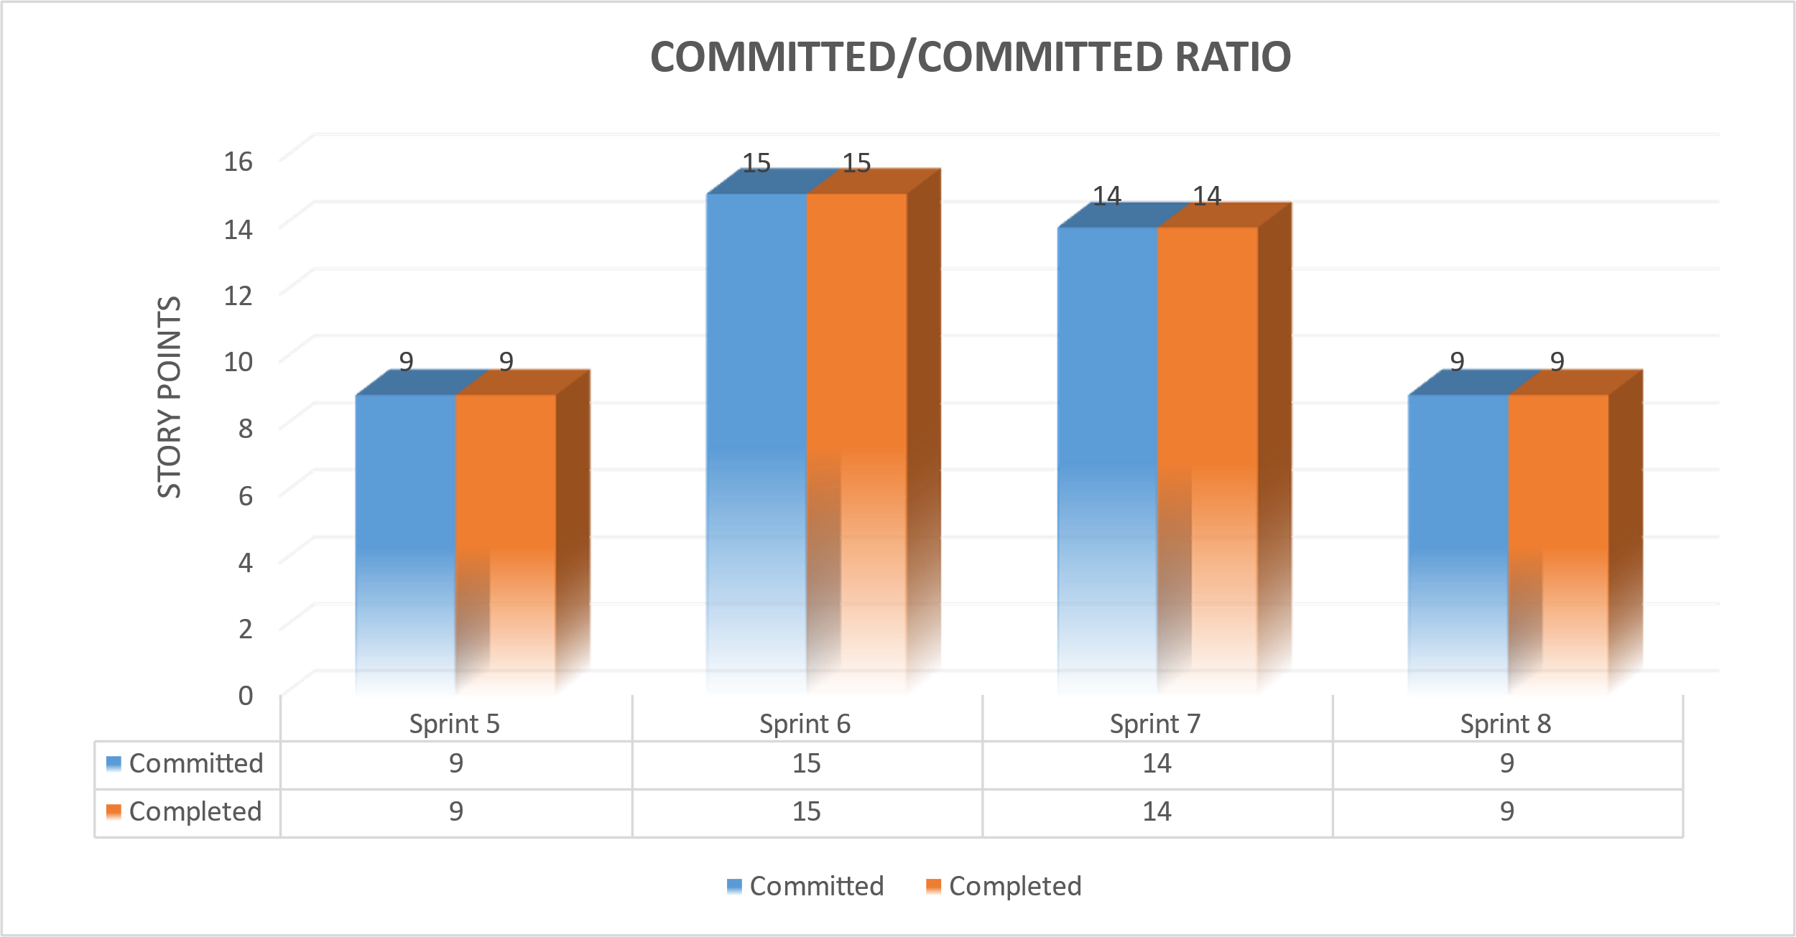
Committed/ Completed
Ratio

Slide 52

RETROSPECTIVE

Slide 53

What went well?
The sprint was well-planned and structured, with clear tasks and deadlines assigned to each team member.
The team had a good understanding of their data and how to visualize it to the user.
Communication was open and transparent, which helped build a strong team dynamic and fostered collaboration.
The team also experimented with new processes, held regular retrospectives.

Slide 54

What did not go well?
The team missed few regular meetings and faced last-minute availability changes, which affected the sprint's progress.
Proactive problem-solving skills were lacking, and the testing process was not as efficient as expected, resulting in last-minute bug fixes.
The team also had difficulties estimating subtasks and not conducting calls that used to happen more than thrice a week.
Additionally, some test cases did not meet the required parameters, and some deadlines were not adhered to.

Slide 55
What needs improvement?
The team should resume regular meetings and establish a process for proactive problem-solving to minimize delays.
To improve the testing process, QA should be involved earlier in the development process, and all subtasks should be estimated at the beginning of the sprint.
The team should conduct two weekly calls as before to share updates and discuss their schedules.
Thorough integration and smoke testing should be done in the last deliverable, and something like daily standups should be held to facilitate collaboration and help teammates who need assistance.

Slide 56
Improvements made from Professor Feedback
Feedback
Improvements
The order of priority for user stories should be listed in descending order.
Updated user stories according to their priority order.

Slide 57

APPLICATION SCREENSHOTS

Slide 58
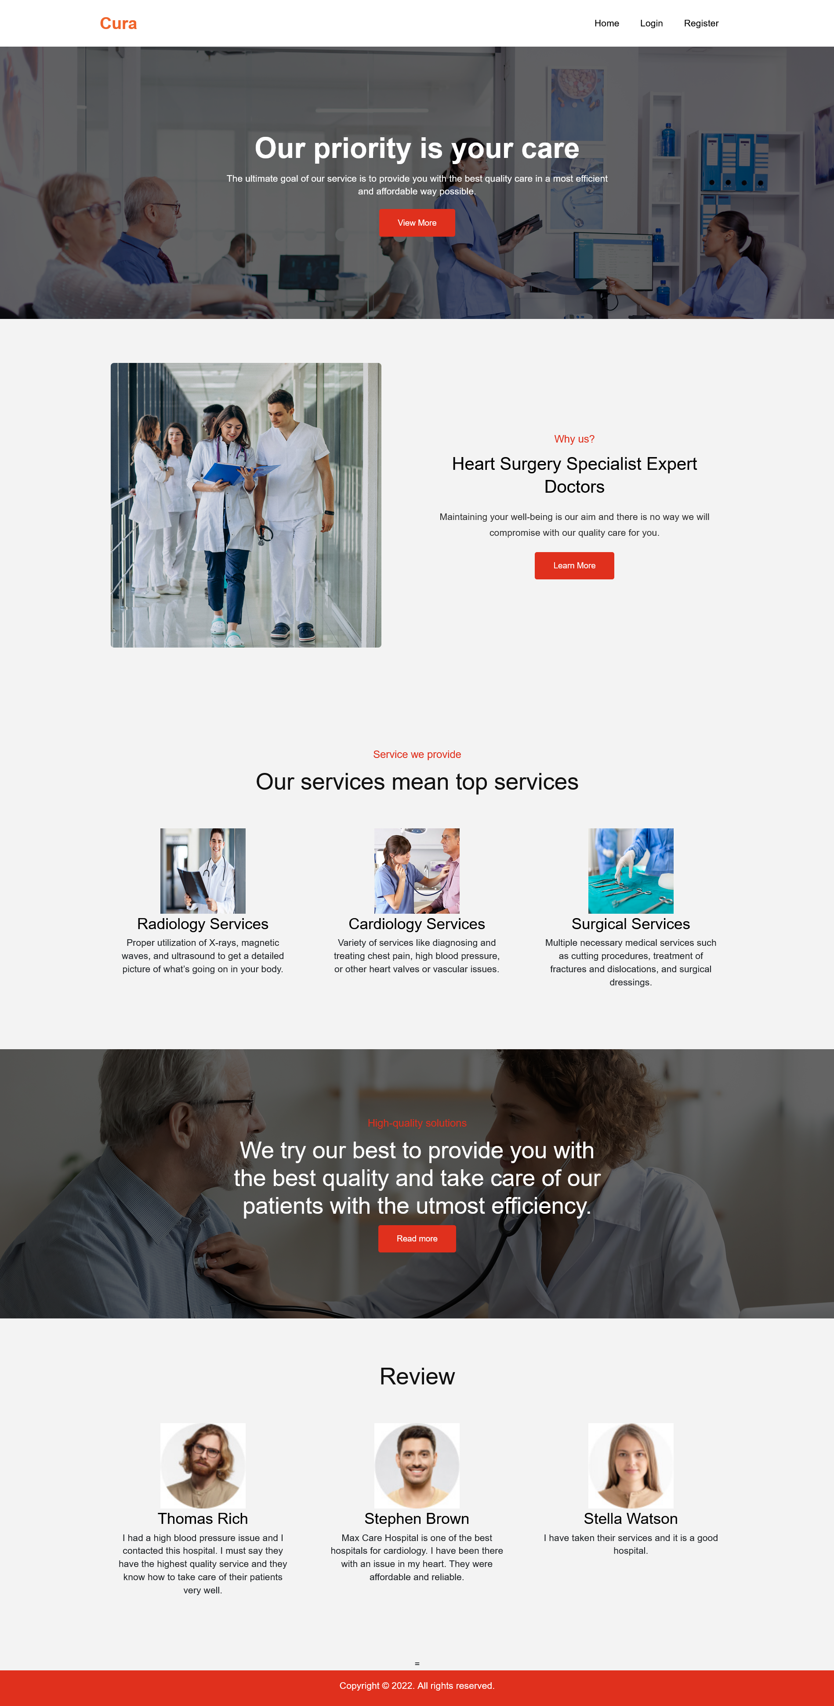
HOME PAGE

Slide 59
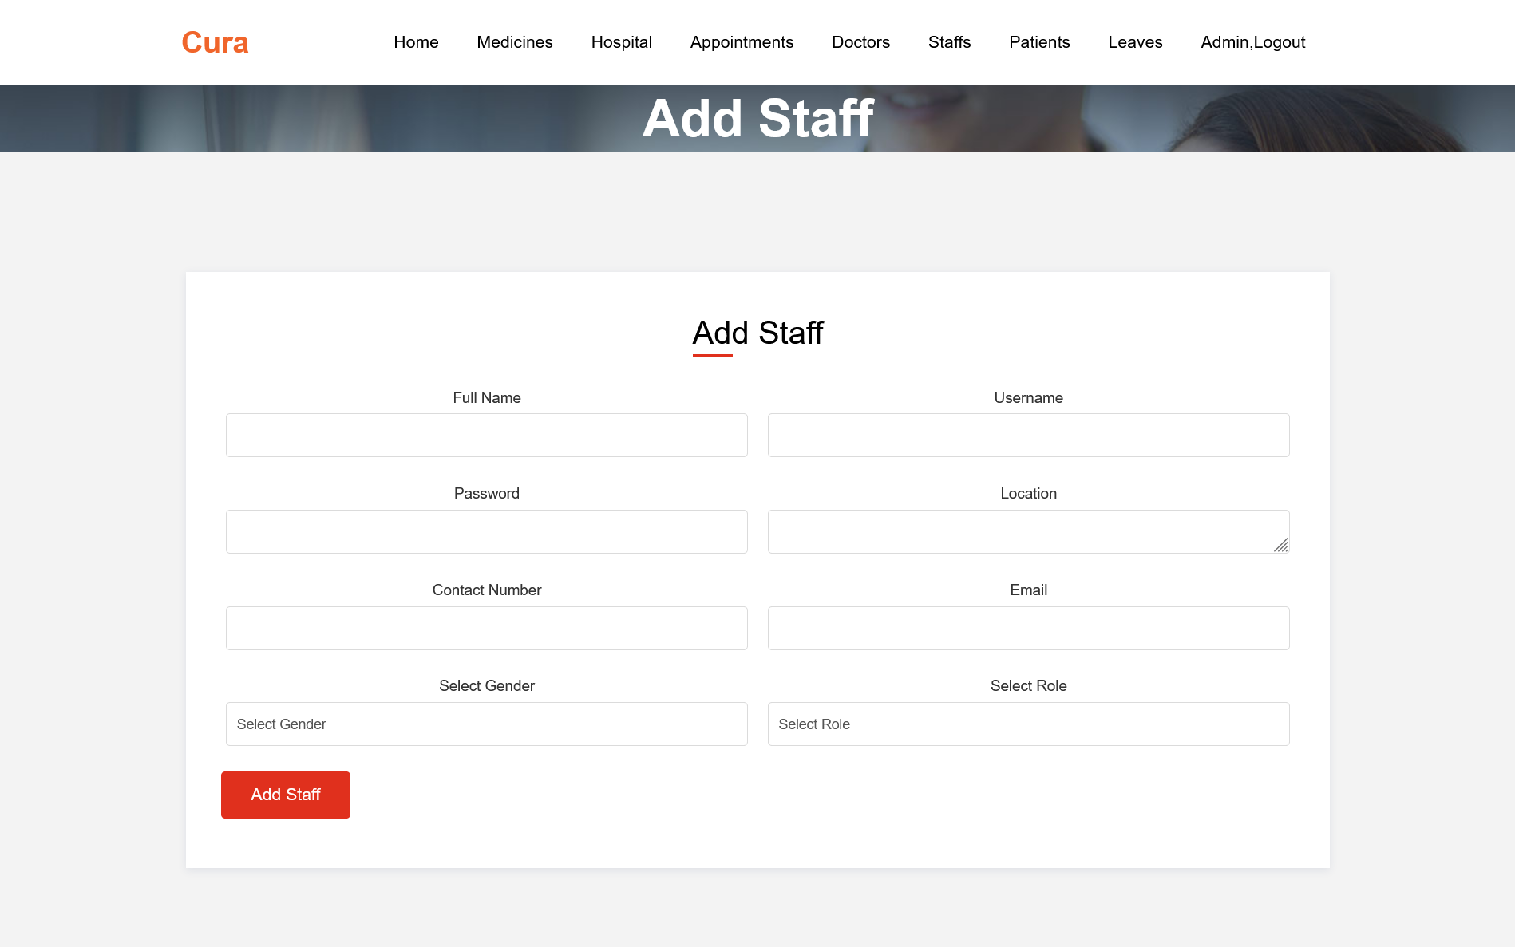
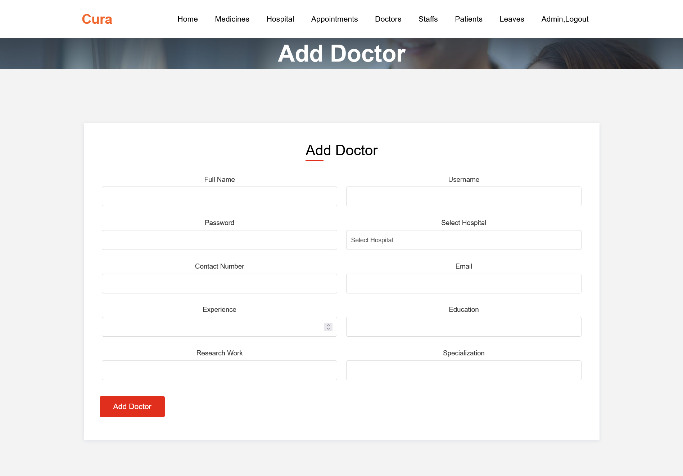
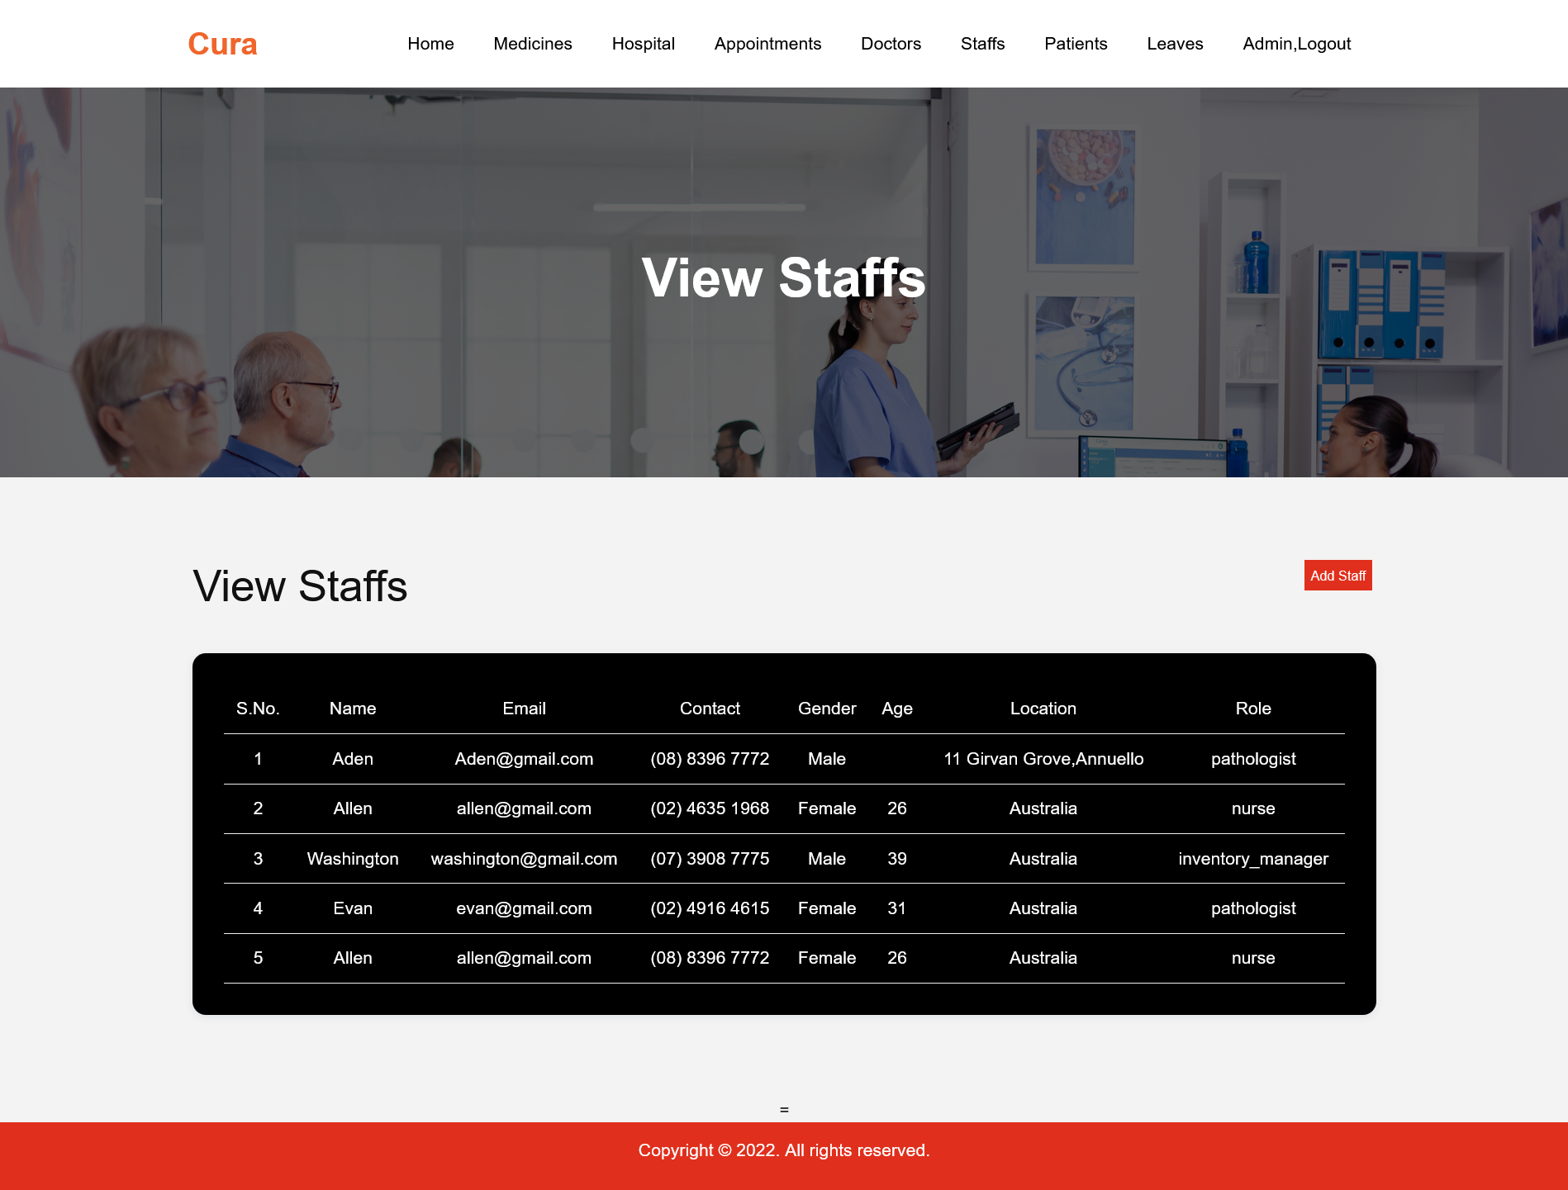
ADMIN PANEL

Slide 60
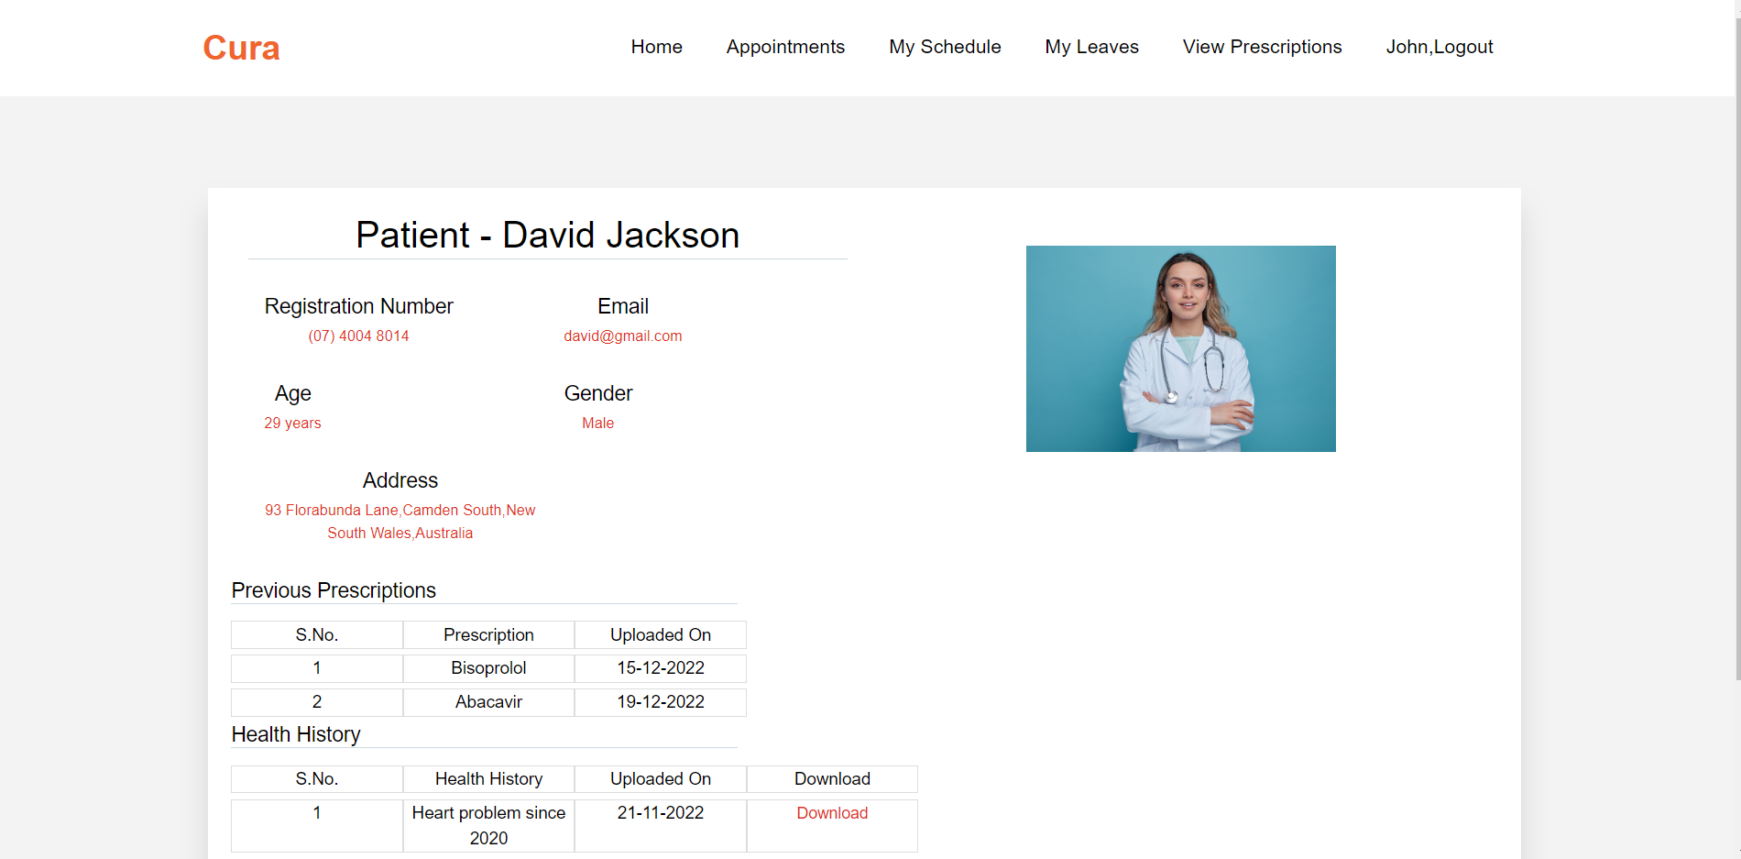
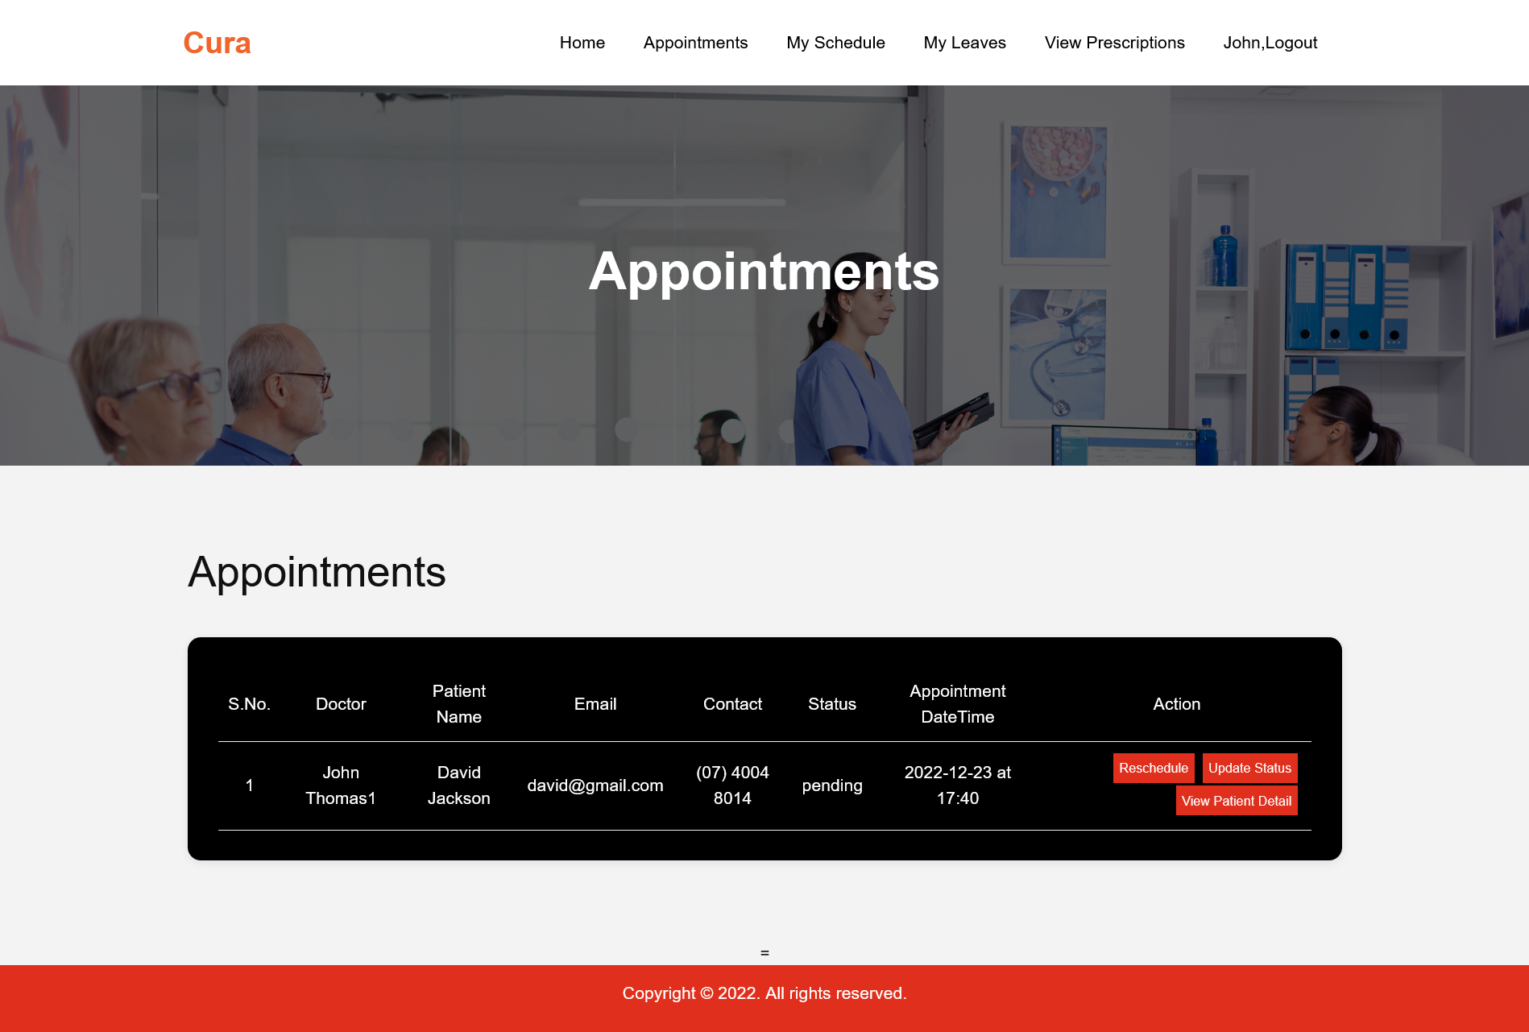
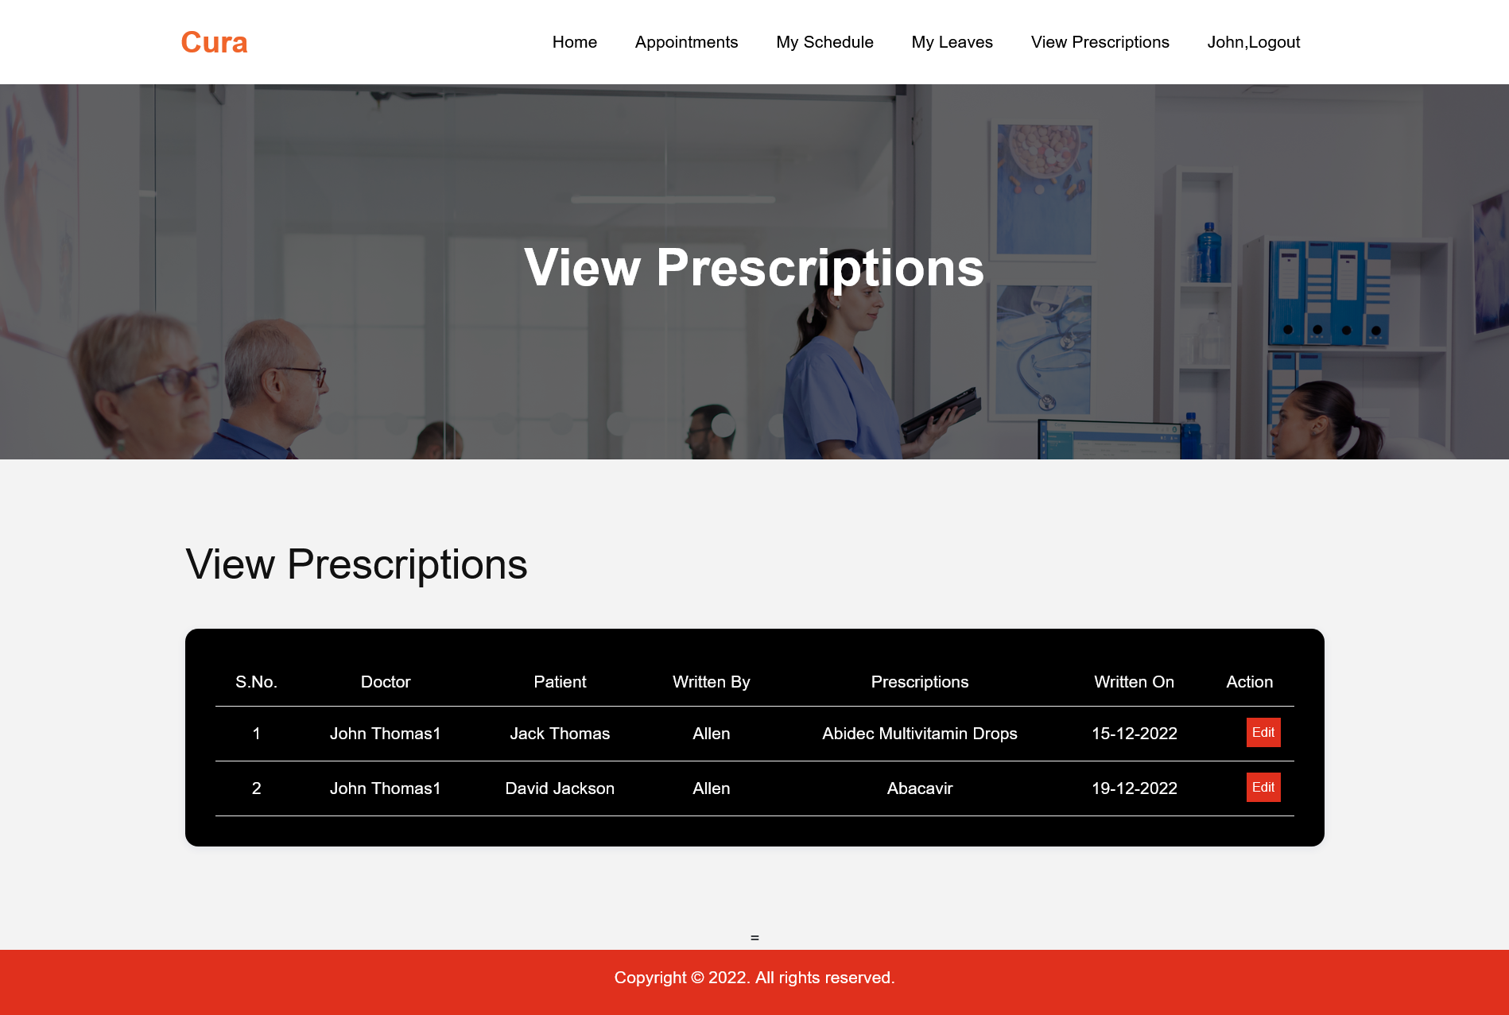
DOCTOR PANEL

Slide 61
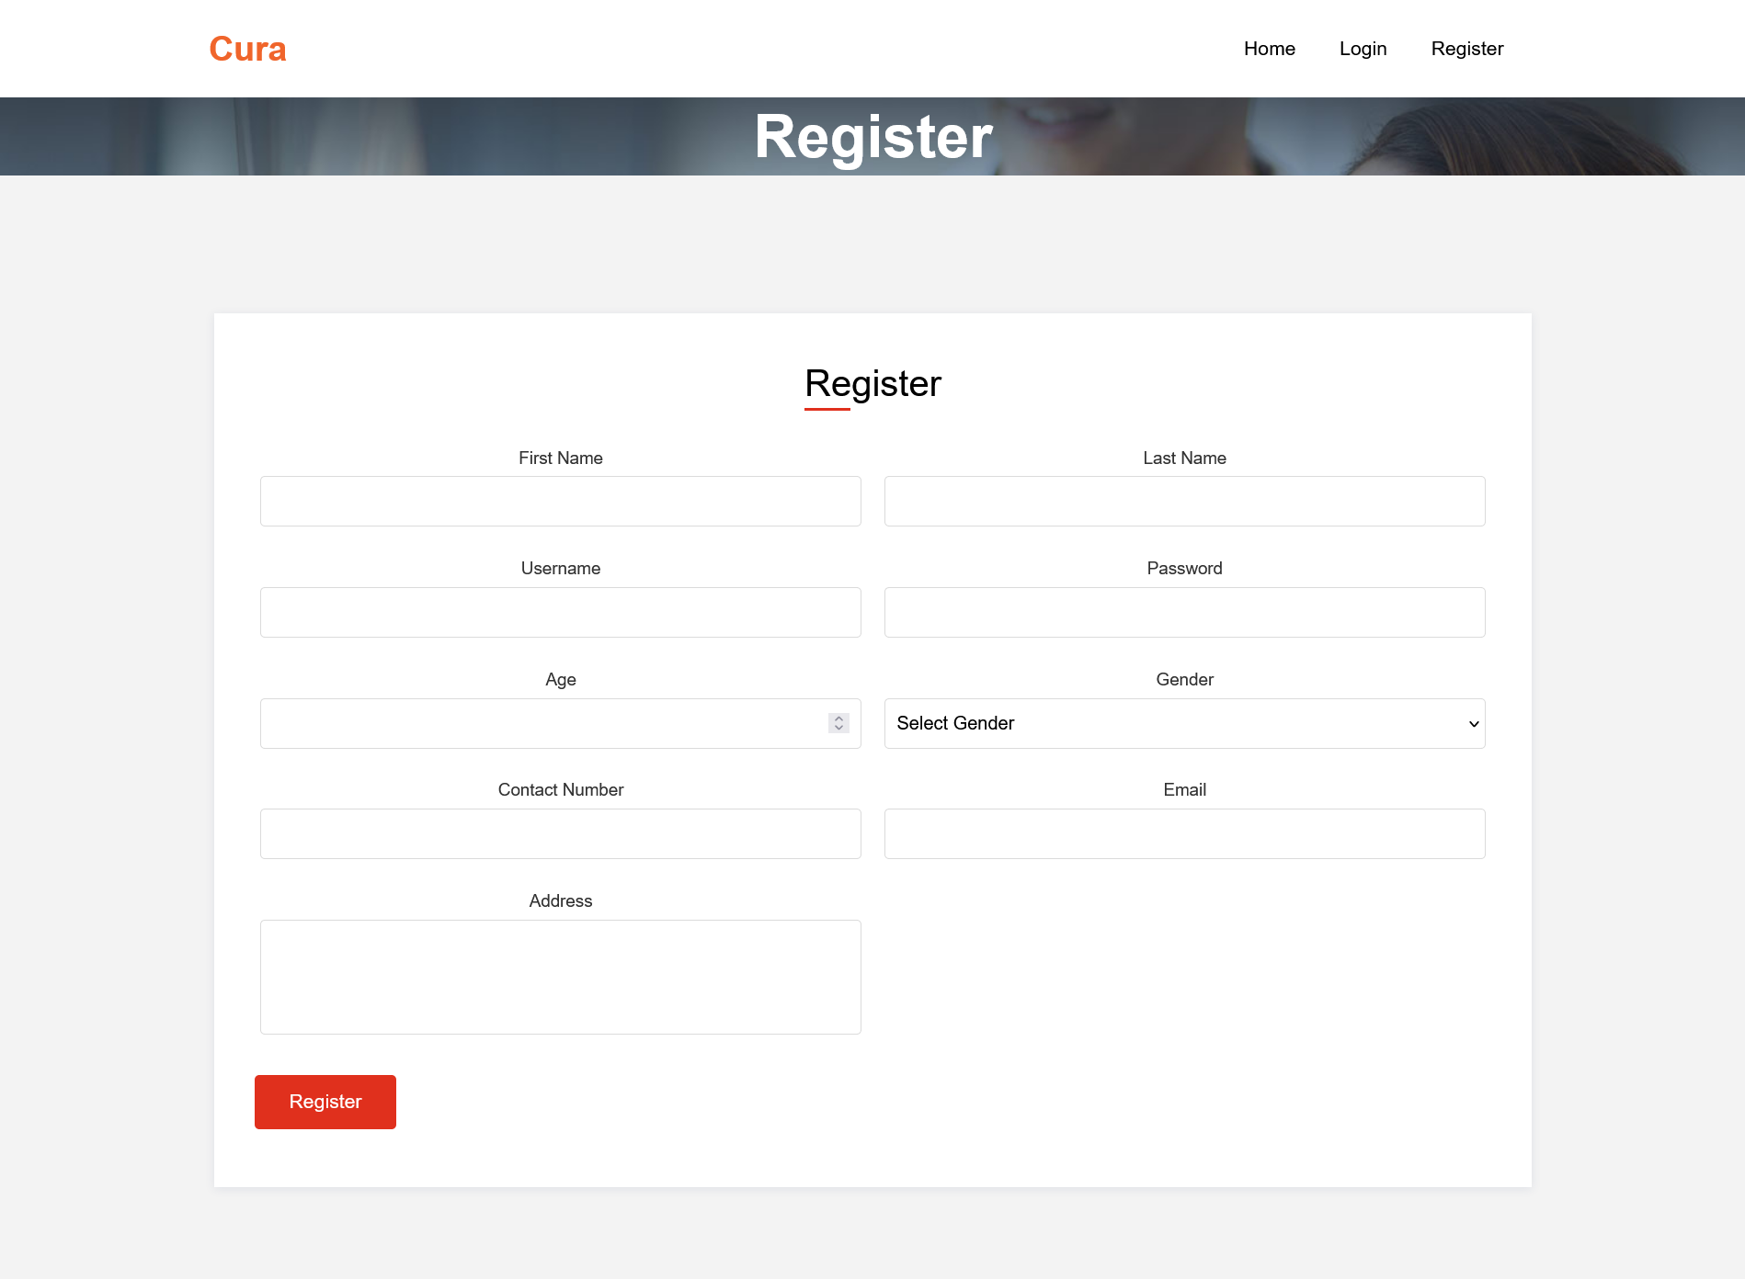
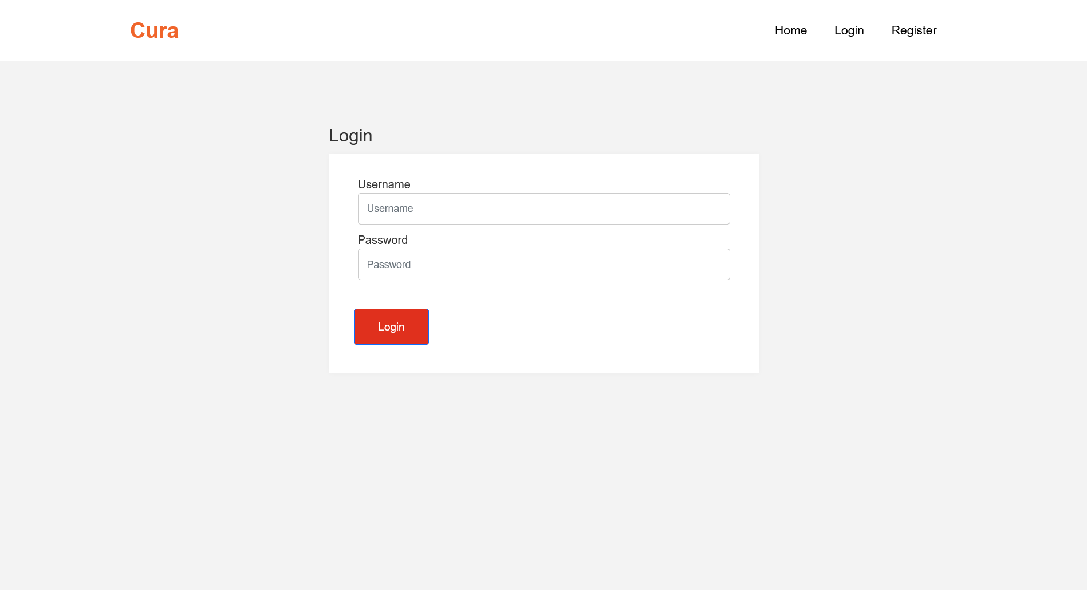
Register & Login Screen

Slide 62
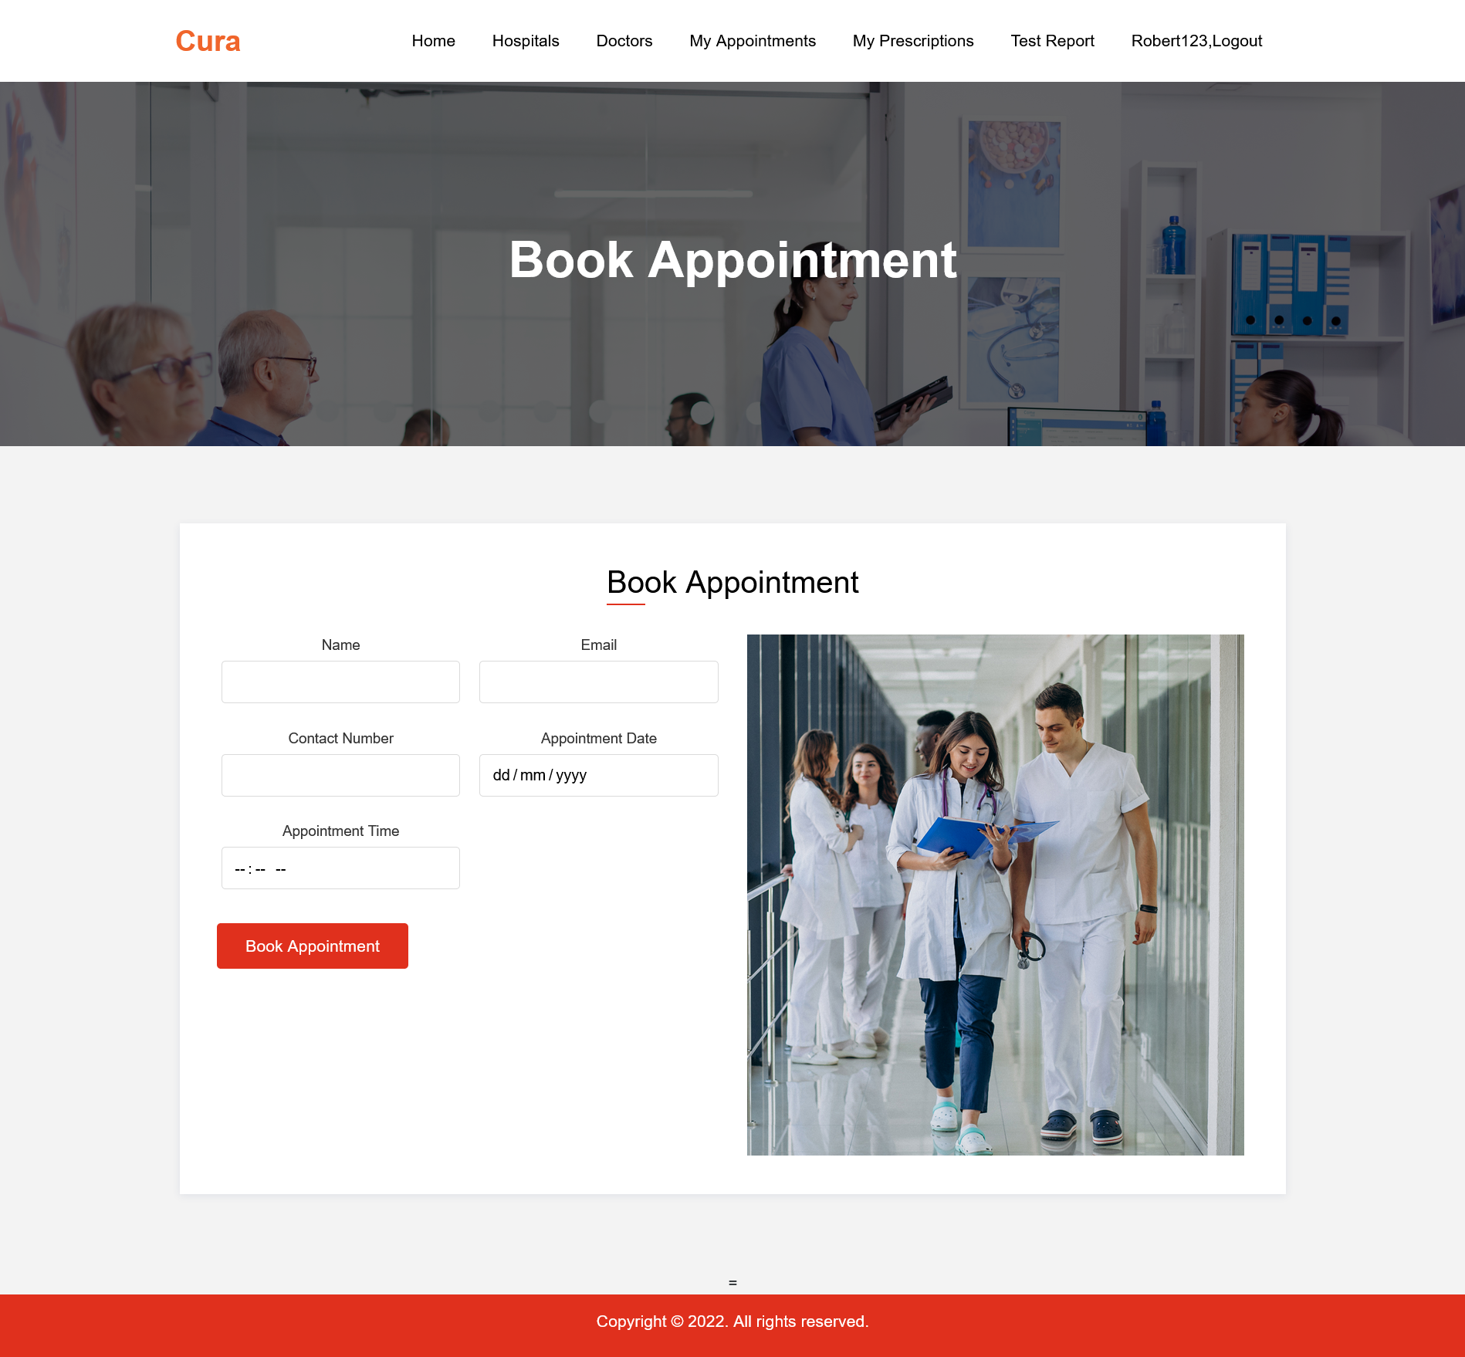
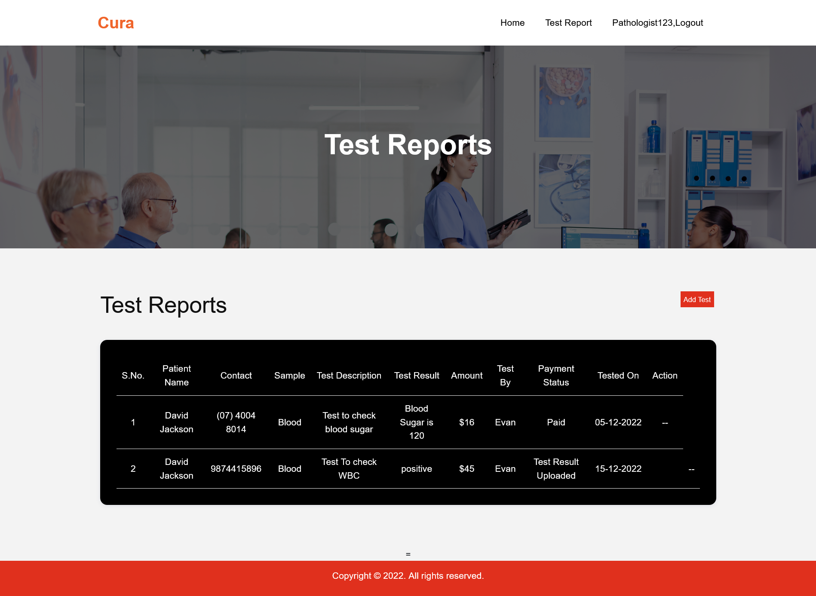
PATIENT PANEL

Slide 63
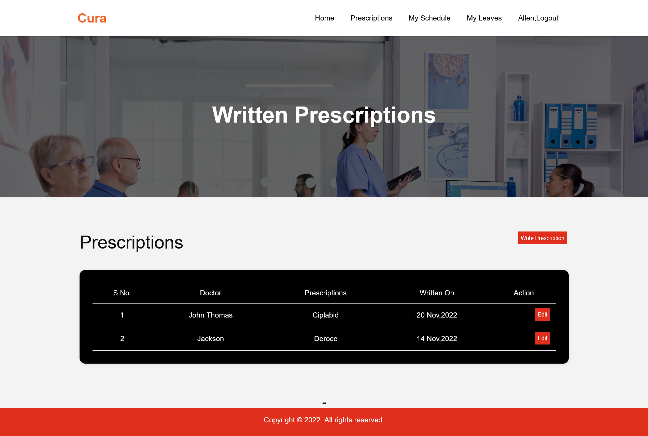
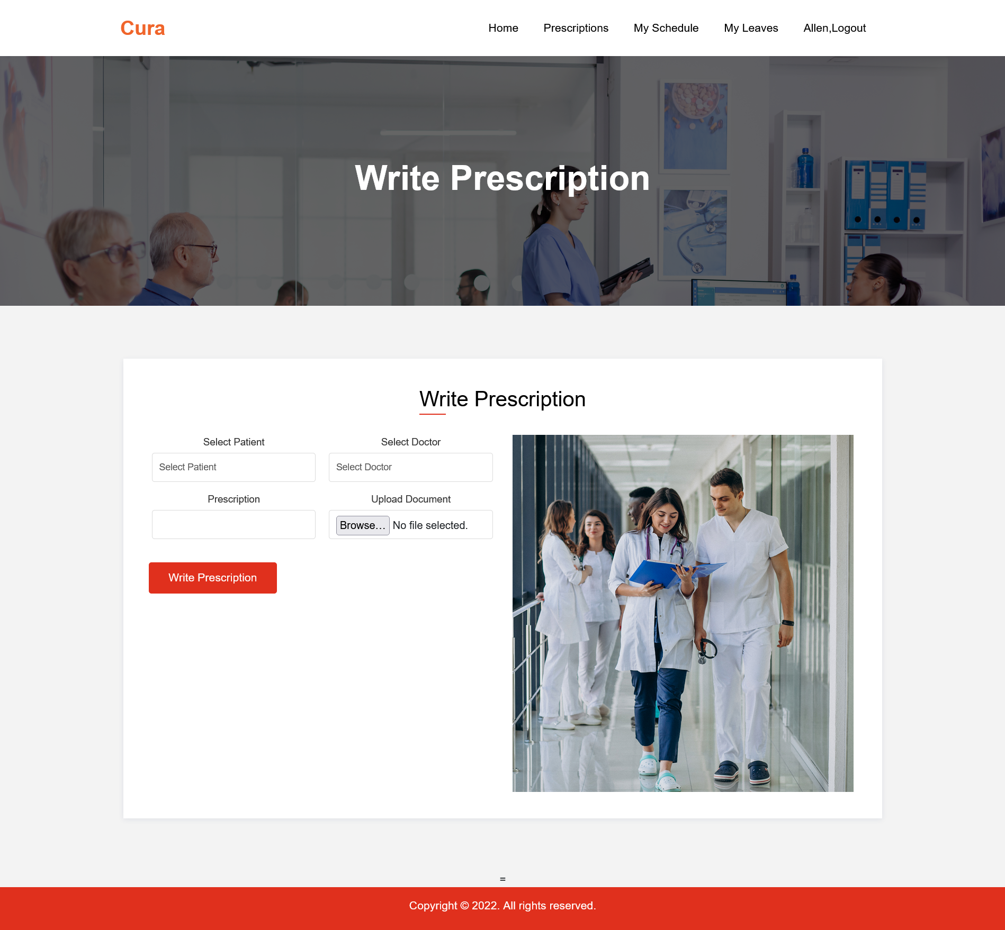
NURSE PANEL

Slide 64
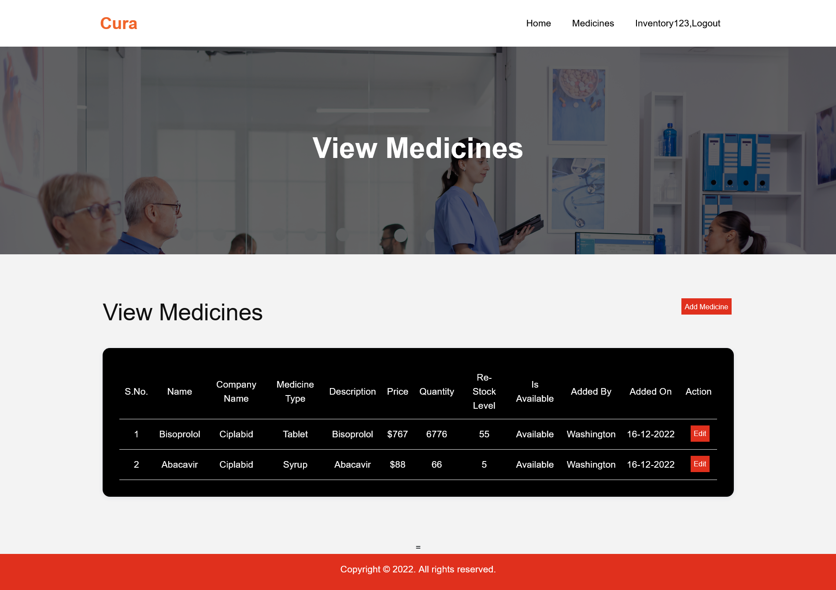
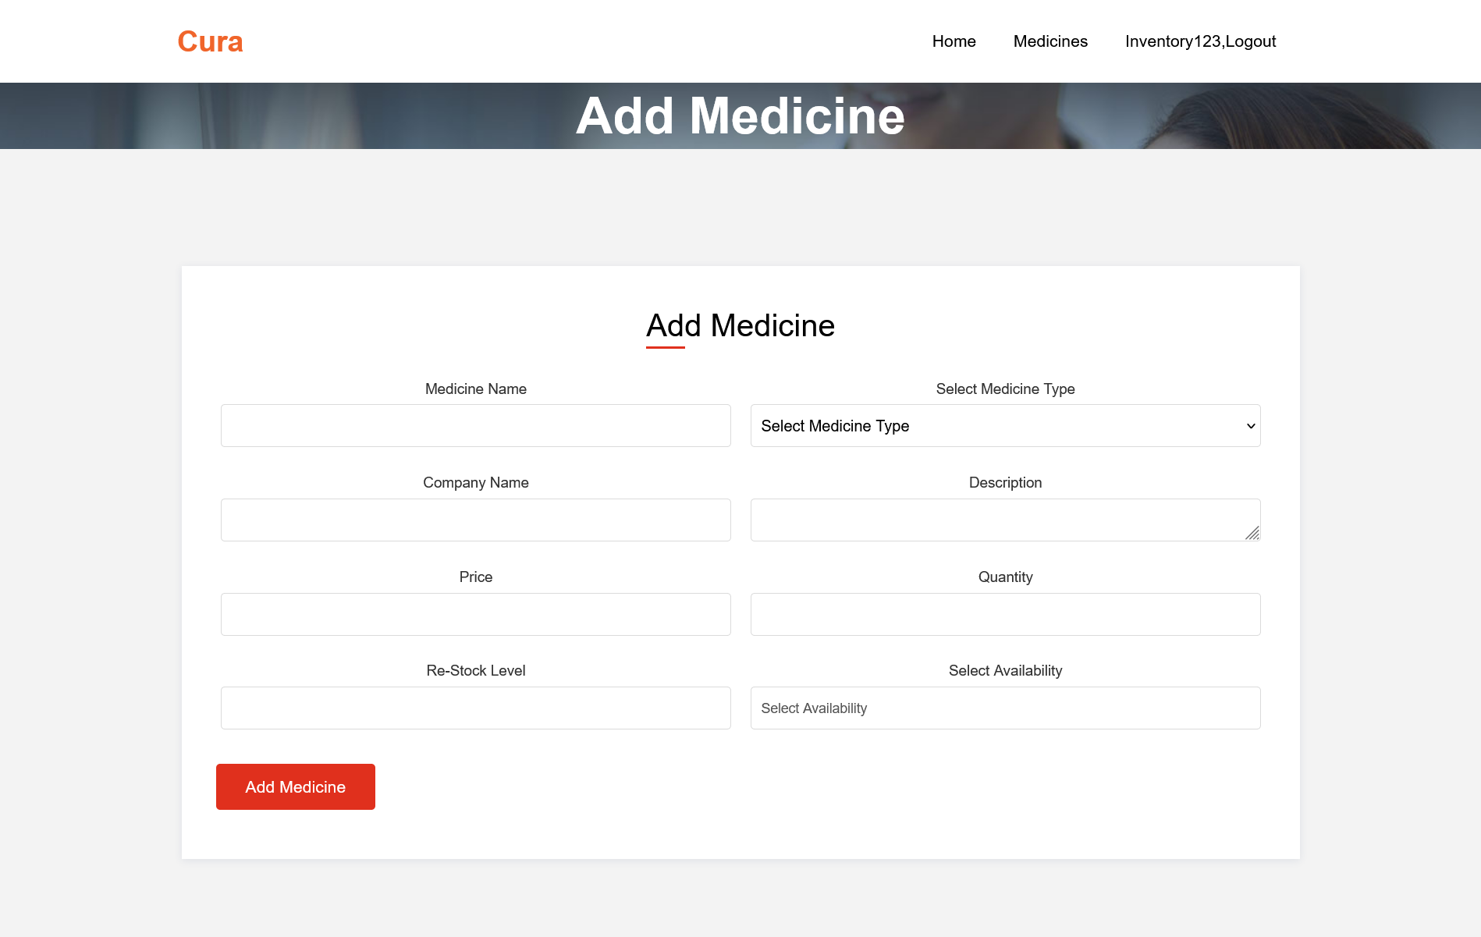
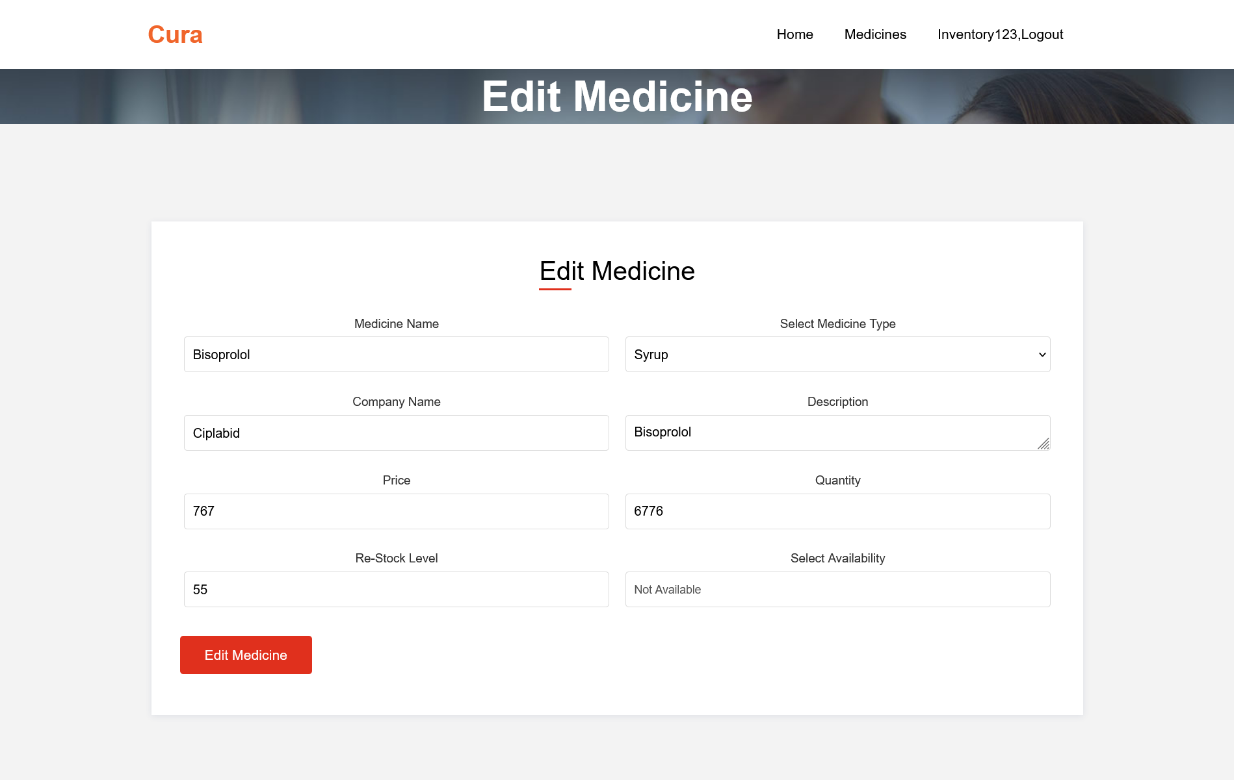
INVENTORY PANEL

Slide 65

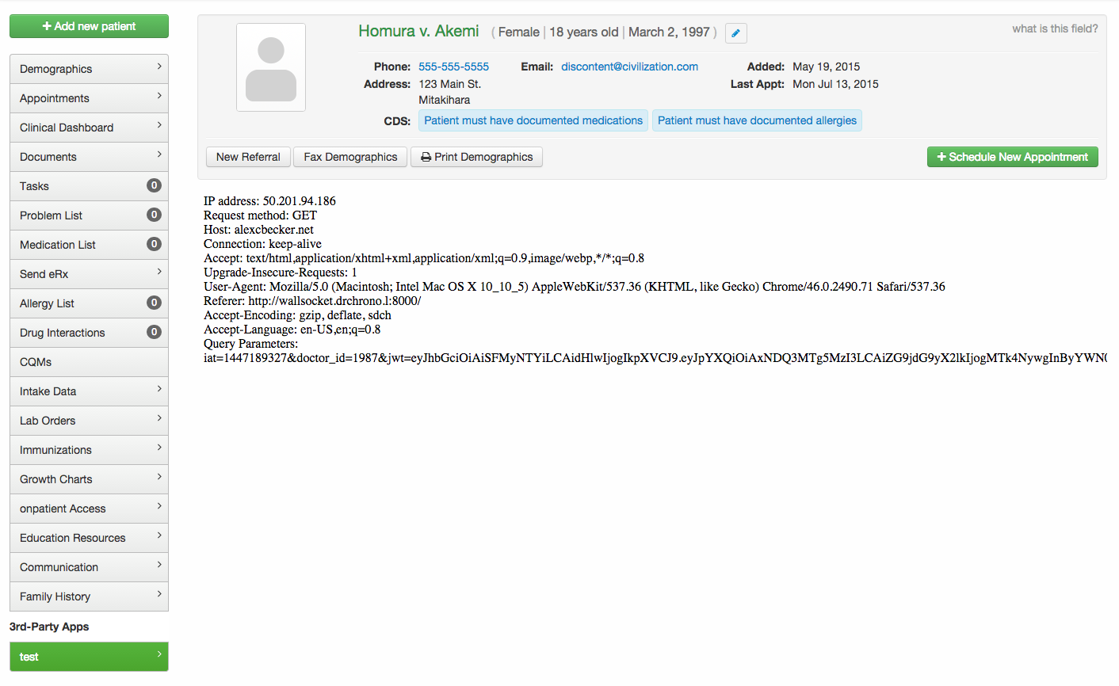

Api used

Slide 66
GitHub Link
https://github.com/htmw/HMS/wiki
Technical Paper Link
CURA TECHNICAL PAPER (GITHUB.COM)
Installation Manual Link
CURA INSTALLATION MANUAL(GITHUB.COM)

Slide 67

THANK YOU
Sai Teja Koribilli
Jigar Shah
Mounika Krishna Thalla
Kuldeep Raj Kaluvala
Bindu Valishetti
Nikhil
Shivansh Tomar

